Slide 1
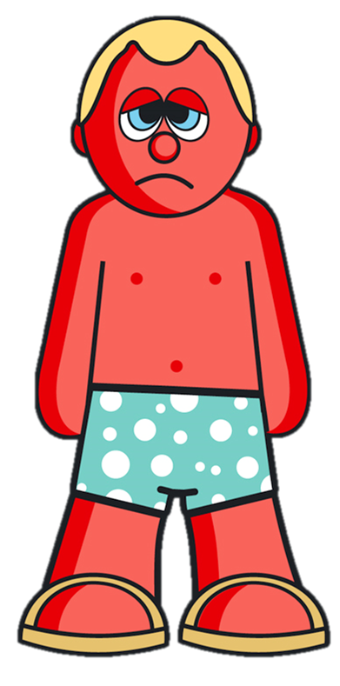
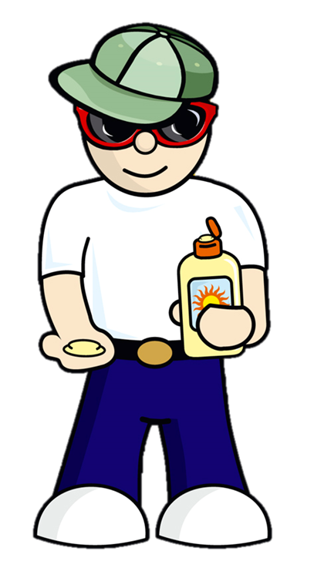
Sun Scientist
Year 5
Notes:
Today you are all going to become Sun Scientists! On the left we have ‘Cool Cal’ and on the right is ‘Sizzling Sam’. What is the difference between the two characters? Cool Cal is wearing a hat, sunglasses and sun cream. He is also wearing clothes which protect his body from the sun. Sizzling Sam is very sunburned!

Slide 2
Learning Outcomes
Pupils will:
Understand that the sun can damage their skin
Know that damaged skin can lead to other health problems after many years
Learn the ‘Slip - Slap - Slop - Slide - Shade’ method to protect their skin
Learn how to carry out scientific experiments using UV beads to measure sun intensity

Slide 3
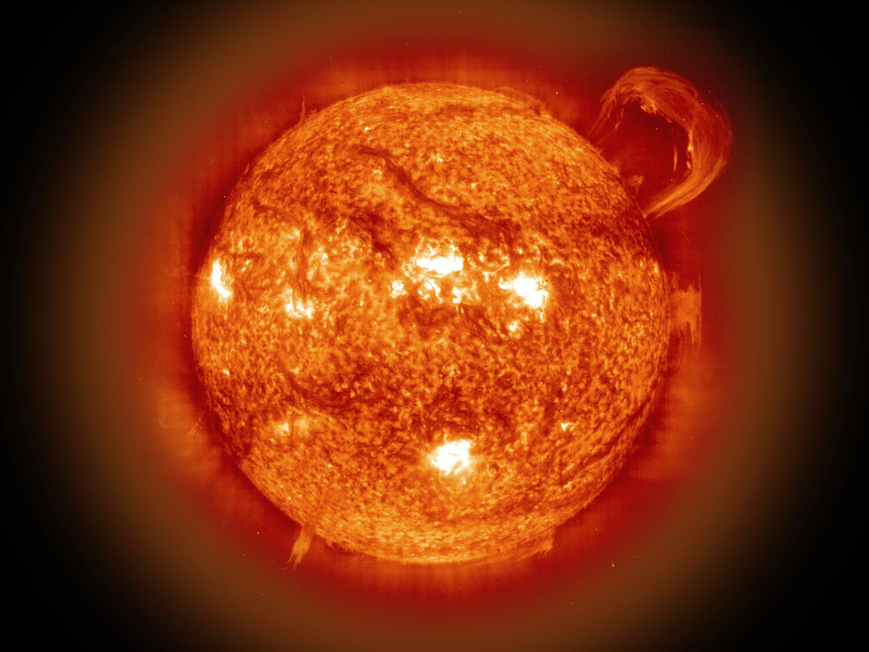


UV Rays
UV Rays
UV Rays
UV Rays
Notes:
This is a picture of the sun. The sun gives off ultra violet rays which are also known as UV rays.

Slide 4
Sun intensity during the day
Early
Morning
Evening
Night
11am – 3pm
Avoid Sun
Notes:
The strength of the sun’s UV rays varies at different times of the day. The strength of these UV rays refers to the sun’s intensity.
The sun’s UV rays are most intense in this country between 11am and 3pm when the sun is at its highest position in the sky.

Slide 5
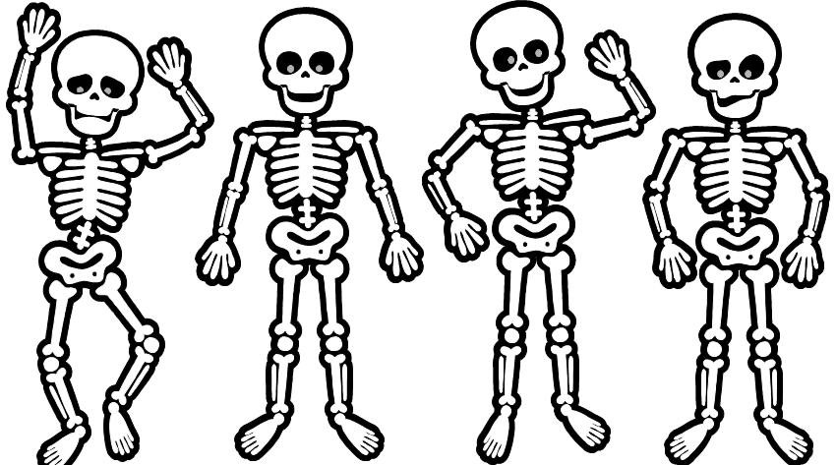
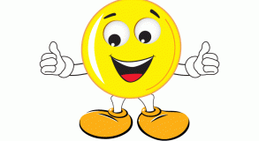
Advantage of the sun’s rays to our body
But we only need a few minutes in the sun to get enough Vitamin D!
Our bones need Vitamin D – we can get this from the sun!
Notes:
Exposure to the sun’s UV rays is the easiest and most common source of Vitamin D. Vitamin D is needed in our bodies to help absorb calcium which is needed for healthy, strong bones. We don’t need to be outside for very long to top-up Vitamin D levels. It takes less time than it takes our skin to redden or burn i.e. a few minutes. You can also get Vitamin D from oily fish, fortified cereals and eggs.

Slide 6
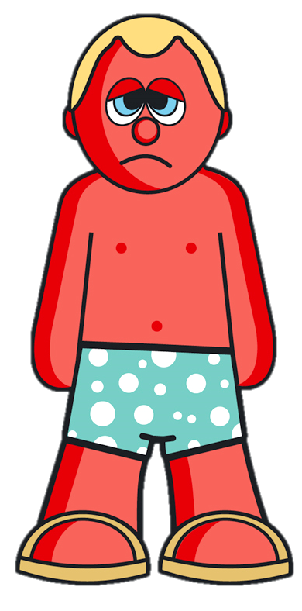


Disadvantage of the sun’s rays to our body
My skin is burned because I did not protect myself from the sun!
Notes:
However over exposure to UV rays can damage our skin and cause it to burn. Sun burned skin shows that your skin has been damaged by being over-exposed to UV rays.

Slide 7

Short-term effects of the sun
When you get burned by the sun:
Your skin can turn red, blister and
peel off
Your body can feel sore
You can get a bad headache
You can feel very ill
Notes:
It is never a good thing to get burned by the sun. Too much sun can cause very unpleasant outcomes!

Slide 8
Long-term effects of sun
If we get burned, our skin is
damaged and this can lead to serious
health problems in the future
Notes:
If you are exposed to too much sun or get sun burned when you are young or get sun burned then it might lead to serious health problems when you are older.

Slide 9
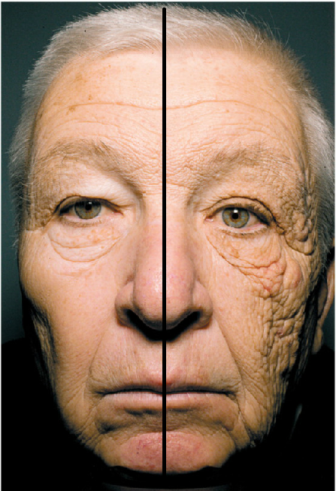
Notes:
This is a lorry driver. In this photo we can see the difference between skin which has been badly damaged by the sun (on the right) and skin which has not been as exposed to the dangerous UV rays (on the left). This has happened because when driving his lorry with the window down, the side of his face which was exposed to the sun has become damaged over many years.
Note: this man is from the USA so he drove in the left hand-side of the vehicle.

Slide 10
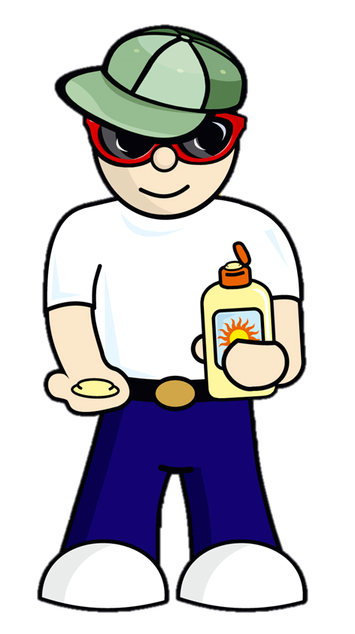
Investigation
As ‘Sun Scientists’ we
will carry out experiments
to investigate how to protect
our skin from sun damage
so that we stay healthy

Slide 11
How will we do this?
Use UV beads to represent our skin
Investigate the impact of the sun on the beads (our skin) under different conditions
Draw conclusions on how best to protect our skin from the sun

Slide 12
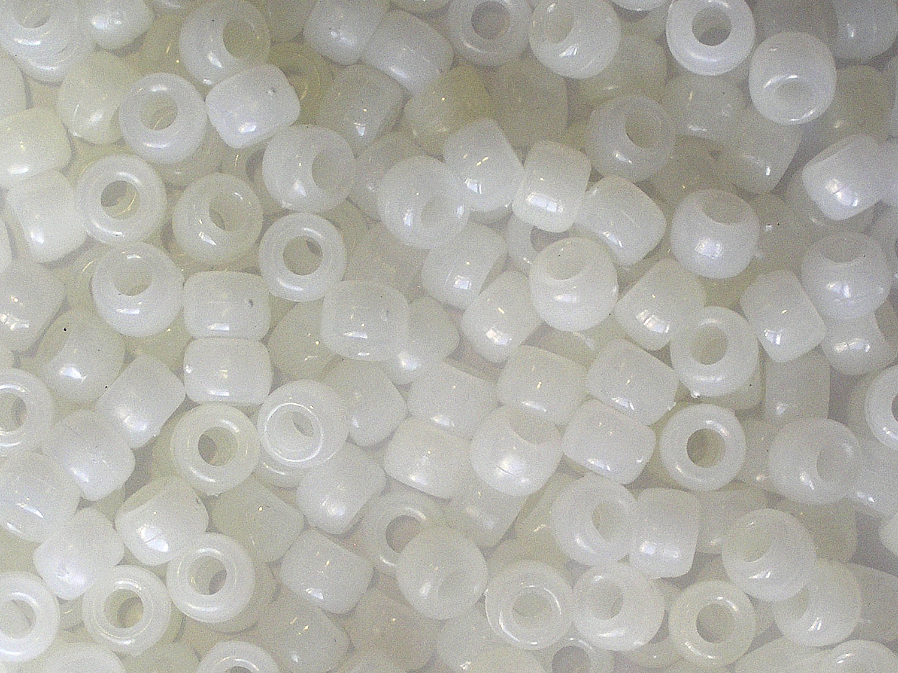
Beads are white when out of UV light
Notes:
These are the UV beads which we will use to represent our skin. Each bead contains chemicals that change colour when exposed to ultraviolet rays from the sun.

Slide 13
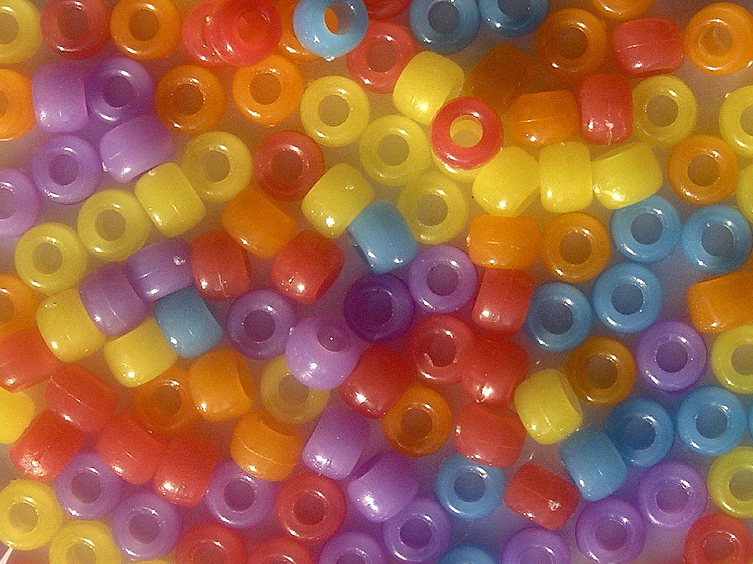
Beads are colourful when in UV light
Notes:
The more exposed the beads are to the sun, the deeper and brighter the UV beads will become. When the beads are only exposed to a little UV light they will only change to pastel (light) colours.

Slide 14
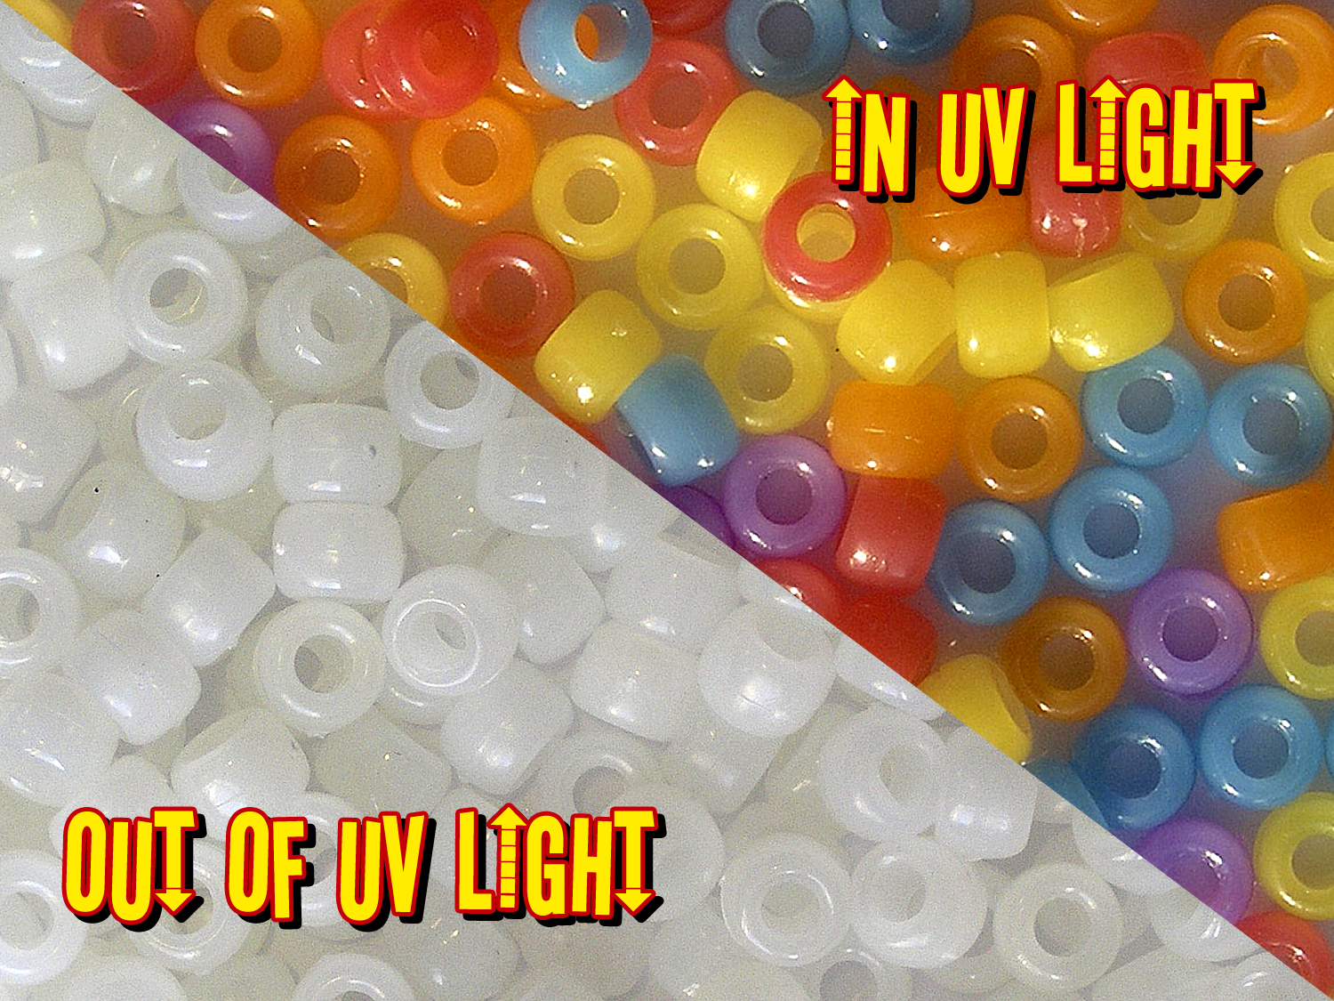

Slide 15
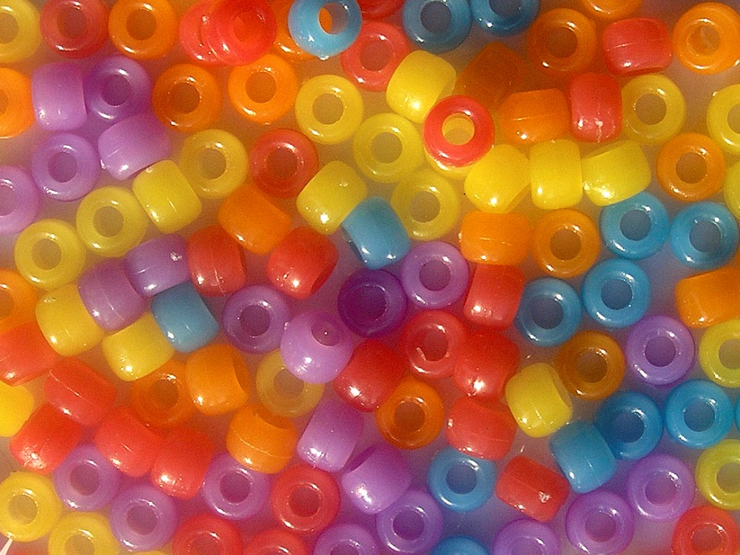
Remember…
=
Notes:
It is important to remember that the UV beads which we will be using today represent our skin!

Slide 16
Six experiments testing the impact of the sun in different conditions:
Outdoors in direct sunlight
Outdoors in direct sunlight but with sun cream on
Outdoors in direct sunlight and covering up with clothes
Outdoors in direct sunlight and under water
5. Outdoors in a shaded area
6. Indoors in artificial light

Slide 17
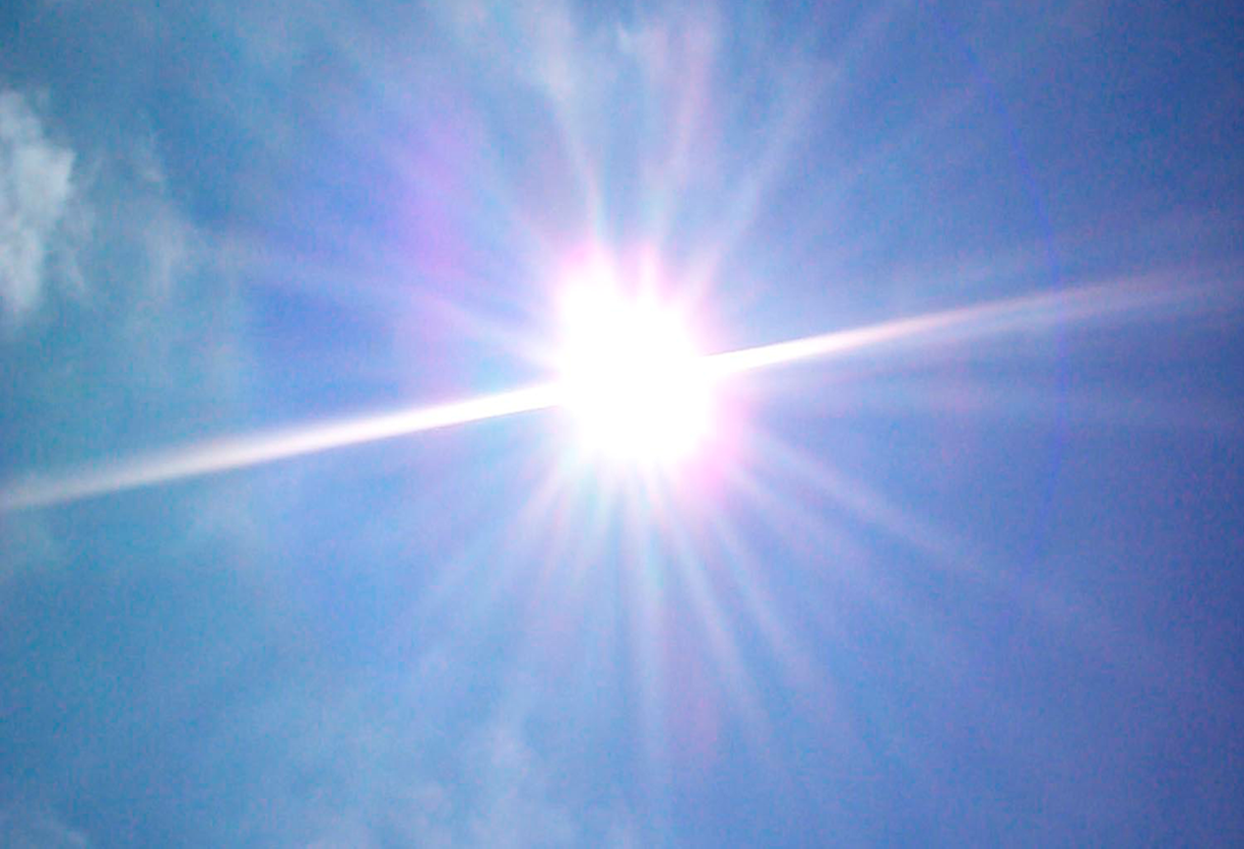
Condition 1: Outdoors in direct sunlight
Notes:
Condition 1 – outdoors in direct sunlight
What area of school would be most appropriate to measure the impact of the sun under this condition?
Answer: playground

Slide 18
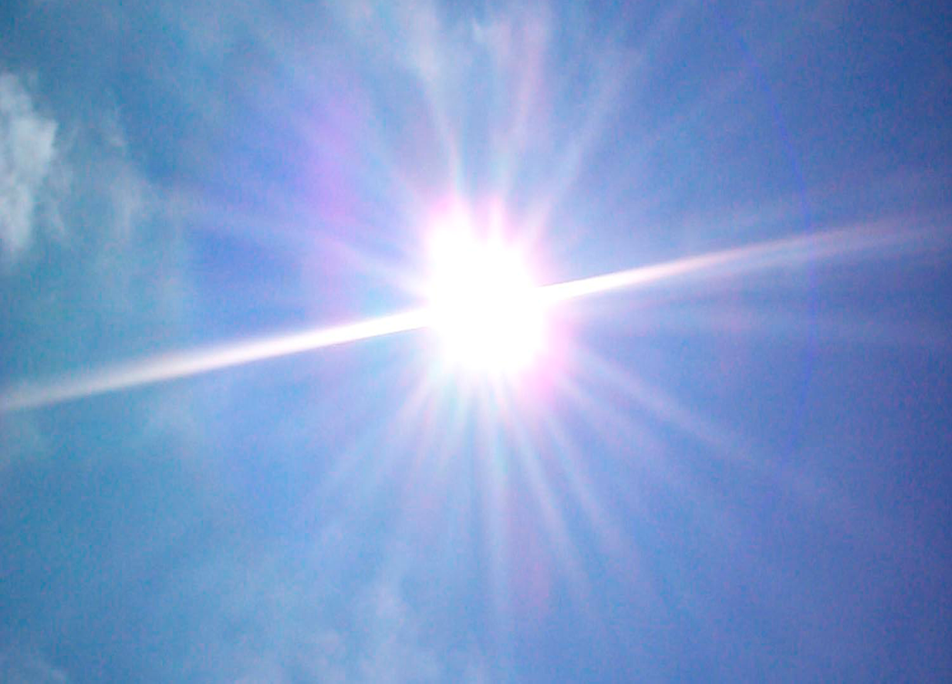
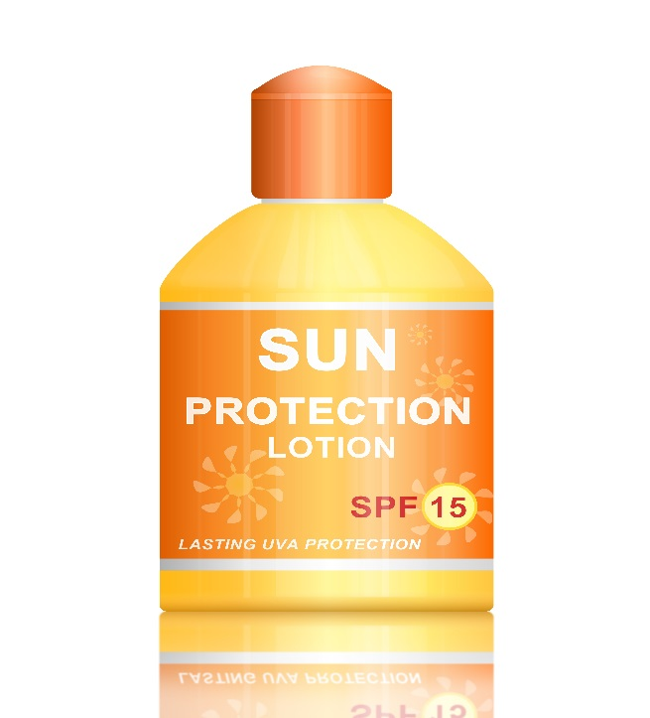
Condition 2: Outdoors in direct sunlight but with Suncream on
Notes:
Condition 2 – outdoors in direct sunlight but with sun cream on
What area of school would be most appropriate to measure the impact of the sun under this condition?
Answer: beads covered in sun cream in the playground

Slide 19
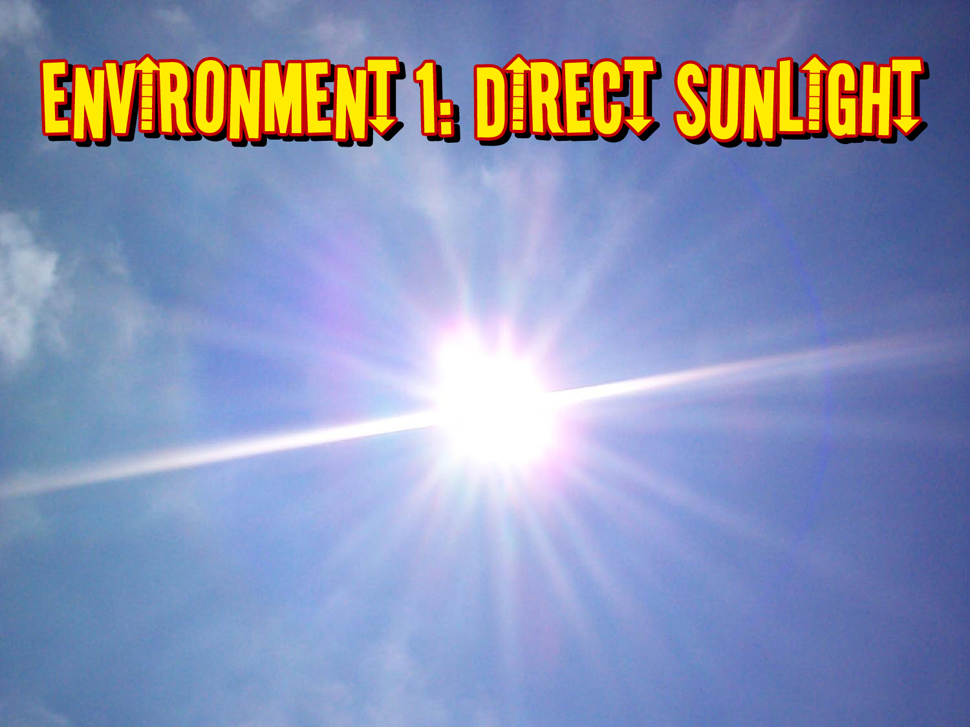
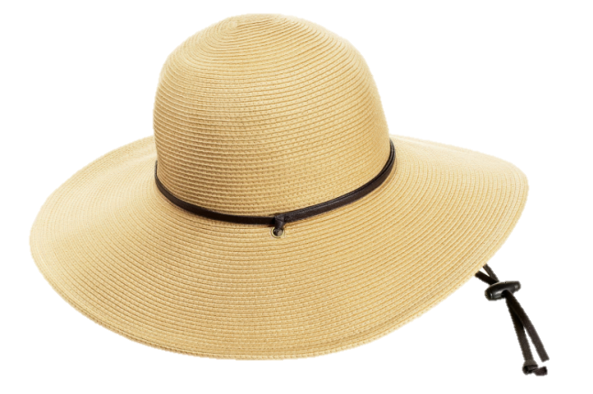
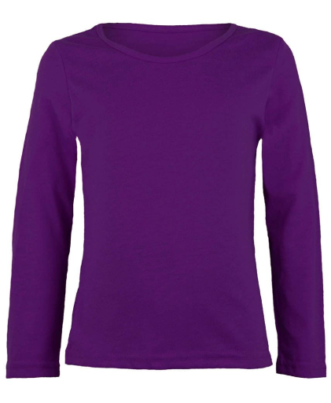
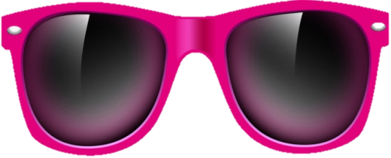
Condition 3: Outdoors in direct sunlight and covered up with clothes
Notes:
Condition 3 – outdoors in direct sunlight and covered up with clothes
What area of school would be most appropriate to measure the impact of the sun under this condition?
Answer: keeping the bead covered up (with clothing) in the playground

Slide 20
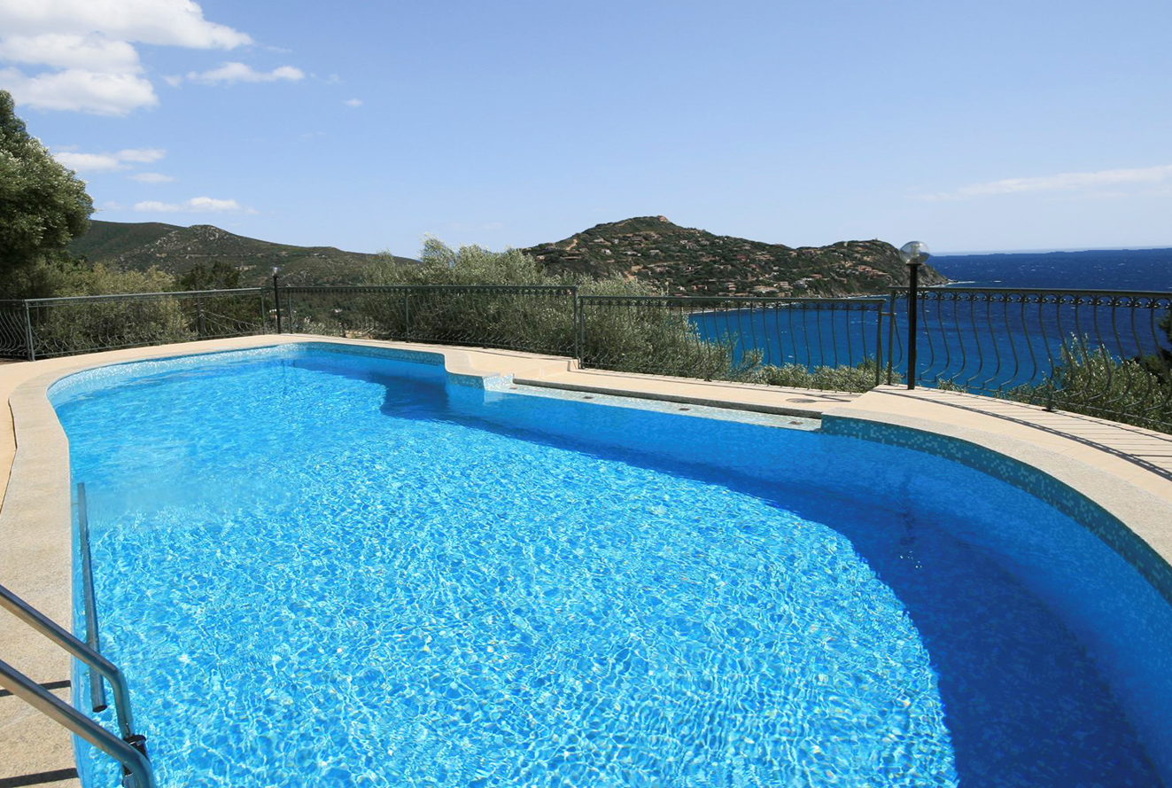
Condition 4: Outdoors in direct sunlight and under water
Notes:
Condition 4 – outdoors in direct sunlight and under water
What area of school would be most appropriate to measure the impact of the sun under this condition?
Answer: outside using a clear container / bottle filled with water

Slide 21
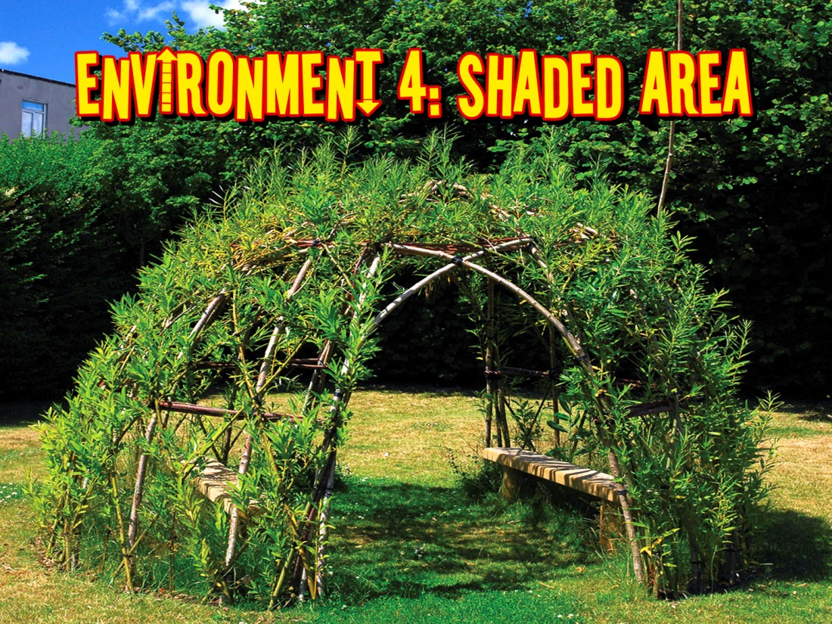
Condition 5: Outdoor in a shaded area
Notes:
Condition 5 – outdoors in a shaded area
What area of school would be most appropriate to measure the impact of the sun under this condition?
Answer: shaded area of playground, for example under a tree

Slide 22
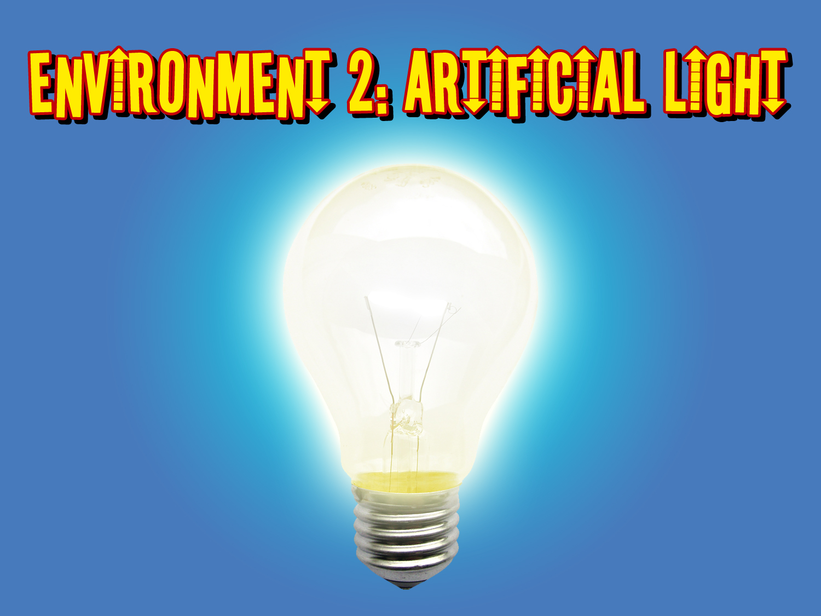
Condition 6: Indoors in artificial light
Notes:
Condition 6 – indoors in artificial light
What area of school would be most appropriate to measure the impact of the sun under this condition?
Answer: blinds closed and lights on in classroom

Slide 23
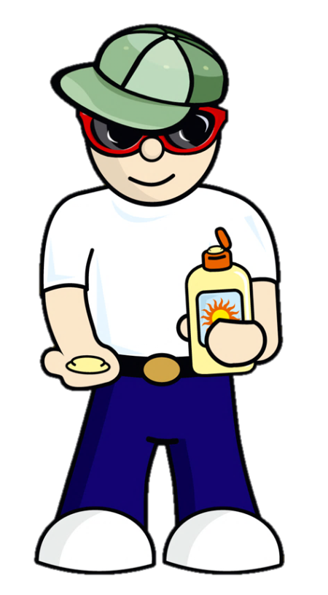
Sun Scientists; time to split into 6 groups!
Each group should investigate the impact of the sun in their given condition, as follows:
Group 1 = Condition 1
Group 2 = Condition 2
Group 3 = Condition 3
Group 4 = Condition 4
Group 5 = Condition 5
Group 6 = Condition 6
Notes:
Teacher notes
Divide class into 6 equal groups 2. Allocate each group with a ‘condition’ 3. Distribute resources accordingly (Please note the tinfoil/dark cloth is to cover the beads before exposing to the UV light) 4. Please note loose UV beads or bracelets (as supplied) should be divided equally between the 6 groups
Group 1 = Condition 1 - Outdoors in direct sunlight. Resources required - Clear sandwich bag, UV beads, tinfoil/dark cloth, Group 1 experiment sheet
Group 2 = Condition 2 - Outdoors in direct sunlight but with sun cream on. Resources required - Clear sandwich bag, UV beads, Sun cream, tinfoil/dark cloth, Group 2 experiment sheet
Group 3 = Condition 3 - Outdoors in direct sunlight and covered up with clothes. Resources required - Clear sandwich bag, UV beads, school jumper, Group 3 experiment sheet
Group 4 = Condition 4 - Outdoors in direct sunlight and under water. Resources required - Clear container/ bottle filled with water, UV beads, tinfoil/dark cloth, Group 4 experiment sheet
Group 5 = Condition 5 - Outdoors in a shaded area. Resources required - Clear sandwich bag, UV beads, tinfoil/dark cloth, Group 5 experiment sheet
Group 6 = Condition 6 - Indoors in artificial light. Resources required - Clear sandwich bag, UV beads, tinfoil/dark cloth, Group 6 experiment sheet

Slide 24

Predictions
Collect the correct experiment sheet for your group
Before you begin your experiment, record your group’s ‘prediction’ on the experiment sheet
What do you think will happen to the beads?

Slide 25
Investigation
Experiment time!
Follow the ‘method’ section on your experiment sheet

Slide 26
Results and Conclusion
When each group has finished the experiment, complete ‘results’ and ‘conclusion’ sections of experiment sheet

Slide 27
Class Results
Now that you have finished your group experiment sheet, complete the
‘Class Results Table’
and discuss findings!

Slide 28
How can we protect our skin from the sun?

Slide 29
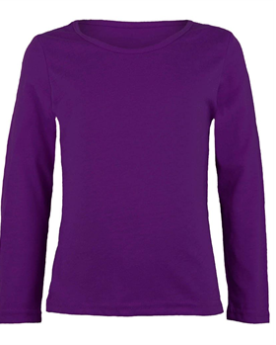
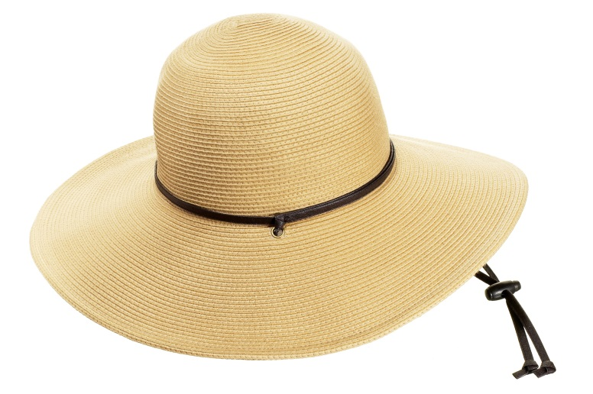

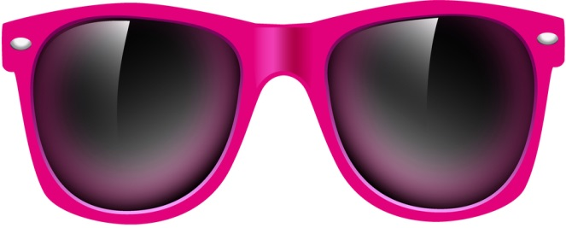
What does Slip-Slap-Slop-
Slide-Shade mean?
Notes:
Slip on a light long sleeved top
Slap on a hat
Slop on some sun cream
Slide on sun glasses
Seek shade between the hours of 11am and 3pm
Discuss: did the results of the experiment support the ‘Slip-Slap-Slop-Slide-Shade’ message?

Slide 30
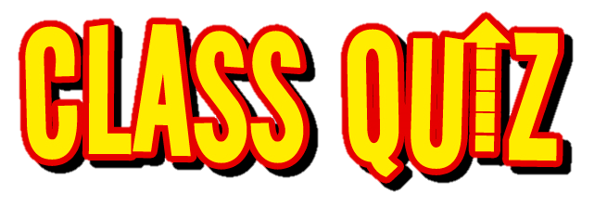

Notes:
We have learned a lot today so now we are going to recap with a class quiz!

Slide 31
What hours of the day is sun intensity greatest?
A. 11am to 3pm
B. 6pm to 10pm
Notes:
Answer: 11am to 3pm

Slide 32
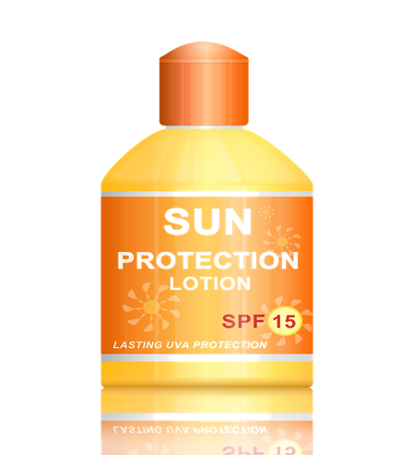
Do you have to reapply sun cream?
Notes:
You should put sun cream on before you go in the sun. Sunscreens rub off. Even if they say they are waterproof, they may come off when you are swimming or can be rubbed off or sweated off. In order to get the best protection, you must reapply them often. Always read the instructions.

Slide 33
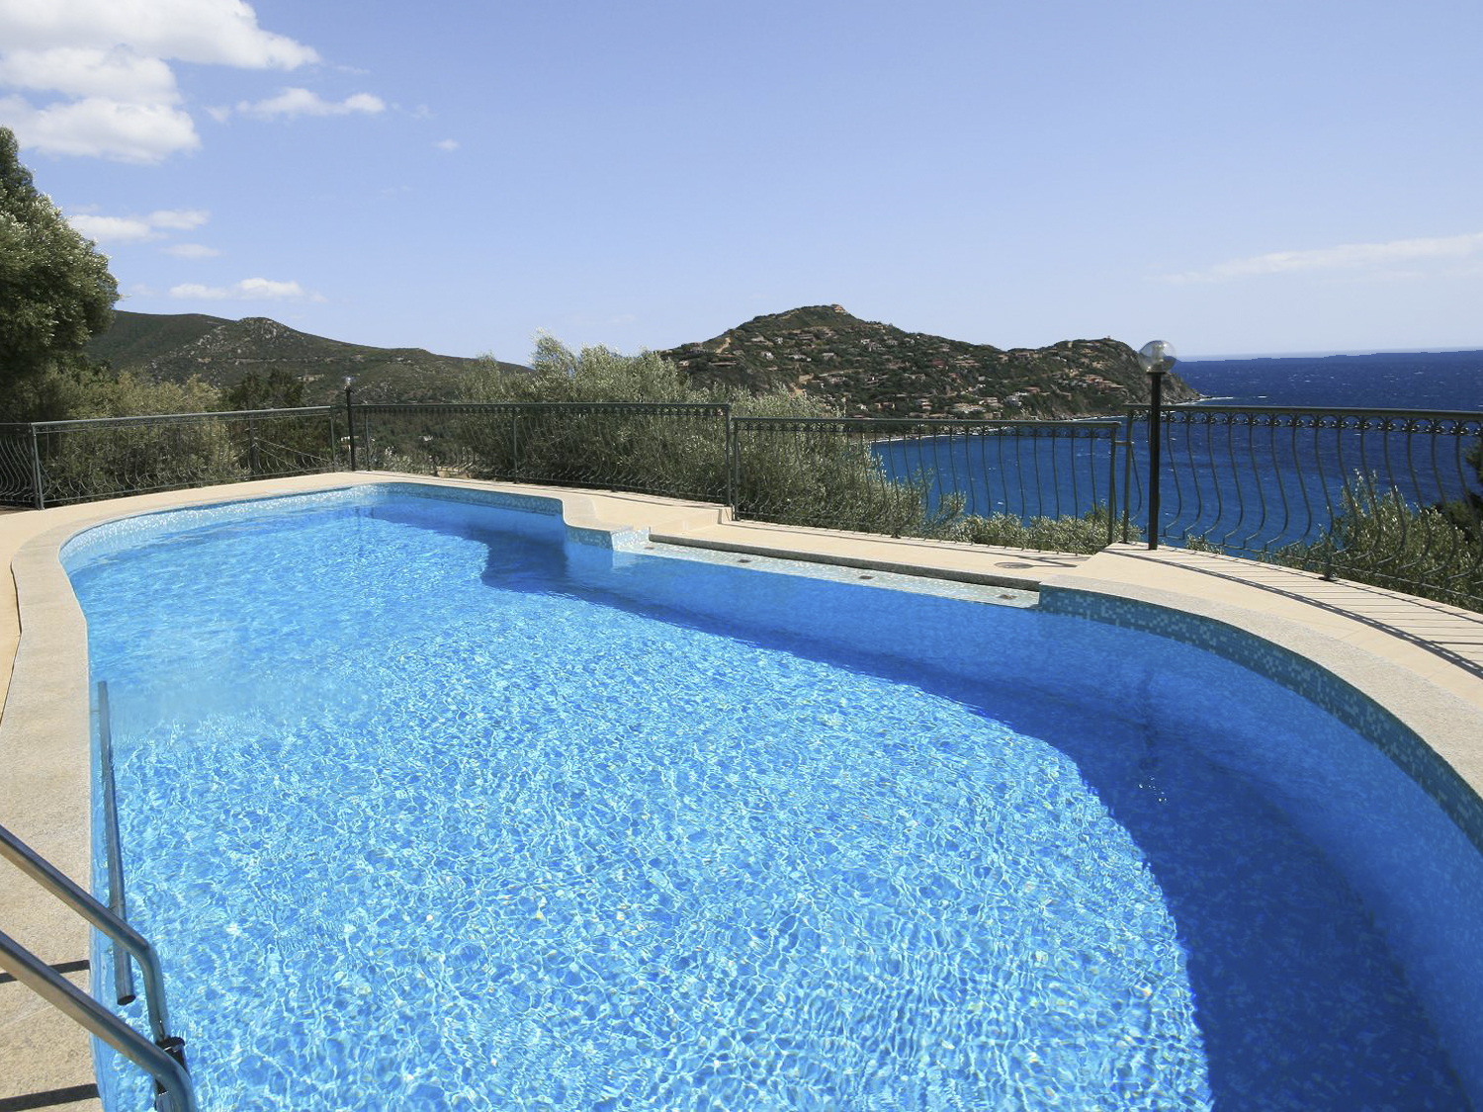
Can the sun still reach your skin in the swimming pool?
Notes:
Answer: Yes- remember how the beads still changed colour in the water.

Slide 34
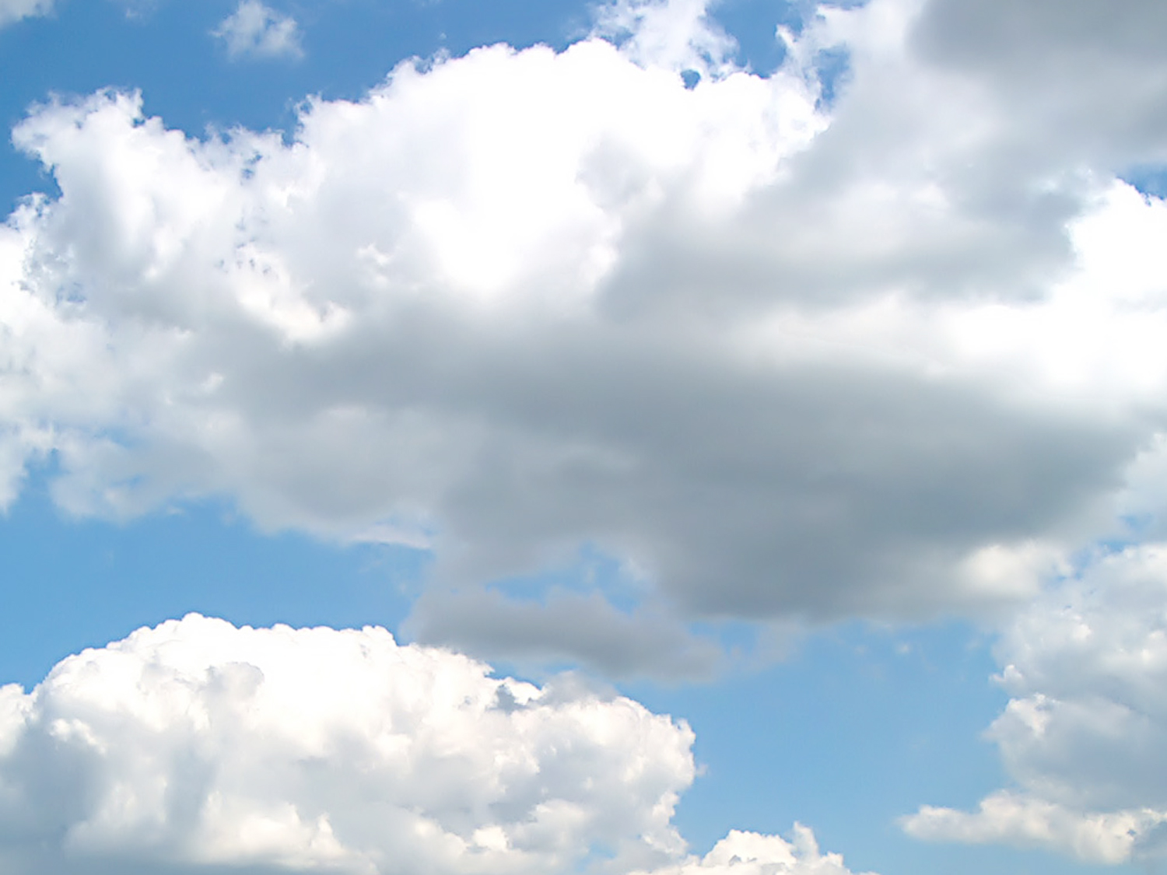
Can your skin get damaged on a cloudy day?
Notes:
Answer: Yes, UV rays can still reach the beads (or your skin) through the clouds.

Slide 35
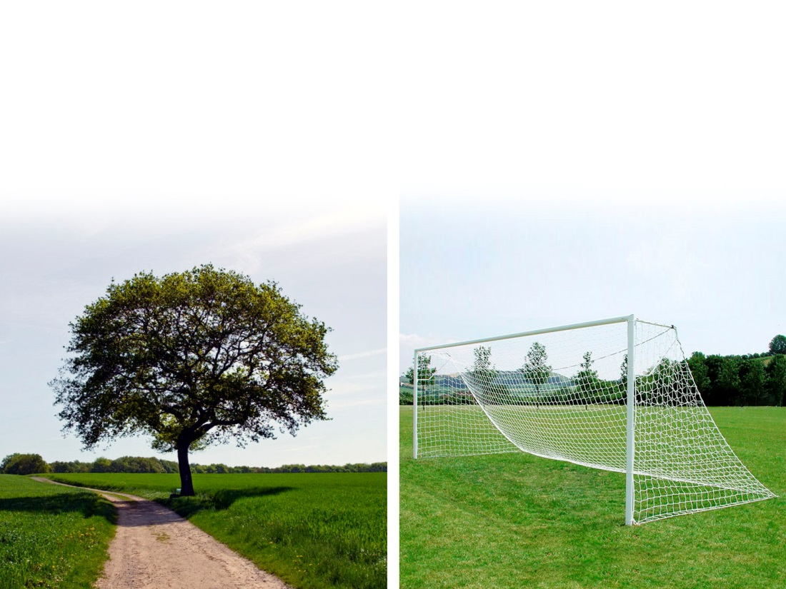
Where would you find shade from the sun?
A. Under a tree
B. Under a goal post net

Slide 36

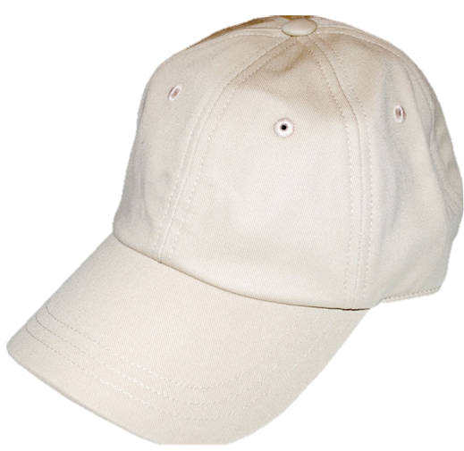
Which of these hats will protect you more in the sun?
A. Baseball cap
B. Wide Brimmed hat
Notes:
Answer: the wide brimmed hat will block out more of the UV rays

Slide 37
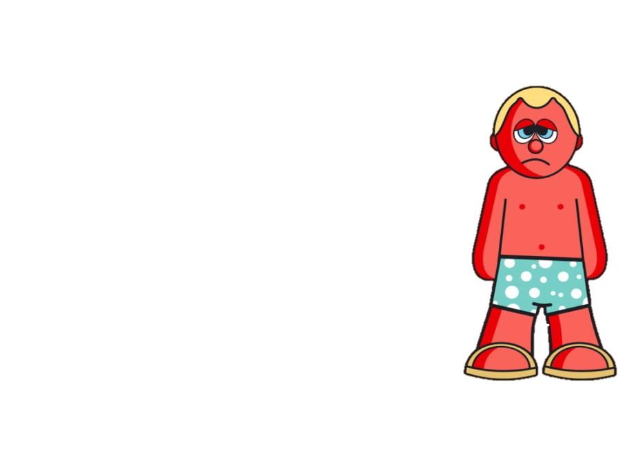
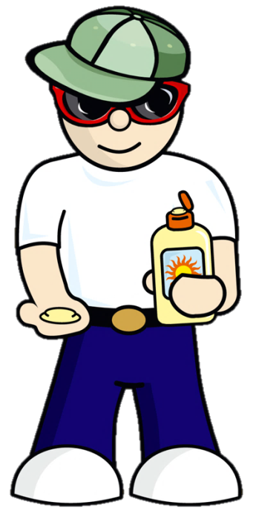

Congratulations!
Class:
Teacher:
You are now Sun Scientists!!

