Slide 1





Year 6

Slide 2
Learning Outcomes
Mission 1: Fact Finding
Learn about how smoke harms the body
Mission 2: Support a ‘Stop Smoking Champion’
Identify and support a member of your community who wants to stop smoking
Notes:
Mission 2: Contact Cancer Focus NI if you need support in completing Mission 2.
Phone: 028 9066 3281
Email: smokebusters@cancerfocusni.org

Slide 3
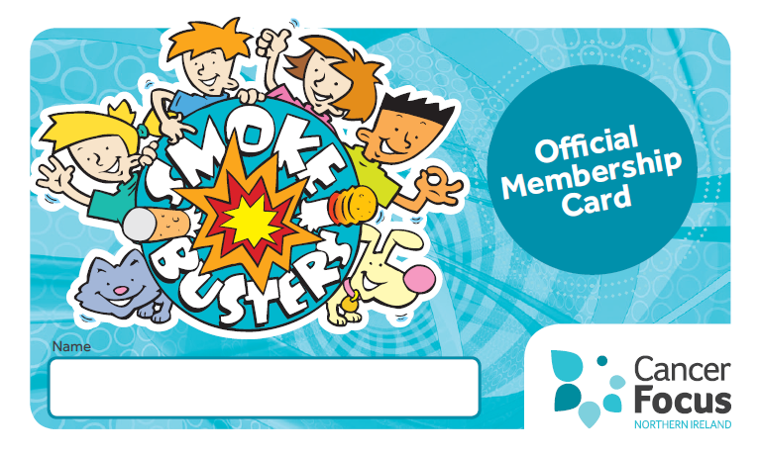
First Official Role…
Sign your
Membership Cards
This is your Smokebusters membership card
Sign it and use it to identify who you are when you carry out official Smokebusters duties!
Notes:
Teachers notes
Distribute membership cards and get pupils to sign.
Discuss the concept of a ‘club’ and what it involves. All members of a club work together and share the same interest for a particular cause.
Last year Smokebuster members came together as a club and campaigned for a ban on smoking in cars carrying children in NI. Club members wrote letters to the health minister asking for this ban to protect the health of young people. As a result of this, this law is now waiting to be approved.

Slide 4


Smokebusters Pledge
Notes:
Teachers notes
Discuss the pledge with your pupils. How are we going to carry out these promises in Year 6.
Why not display your Pledge in your classroom

Slide 5
Mission 1
Learn about how tobacco smoke harms the body

Slide 6
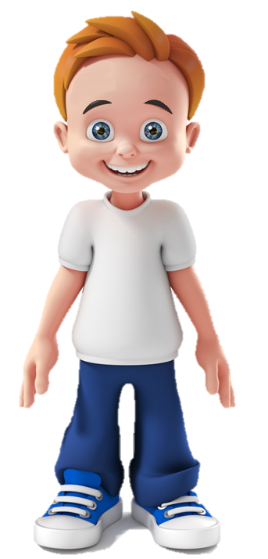
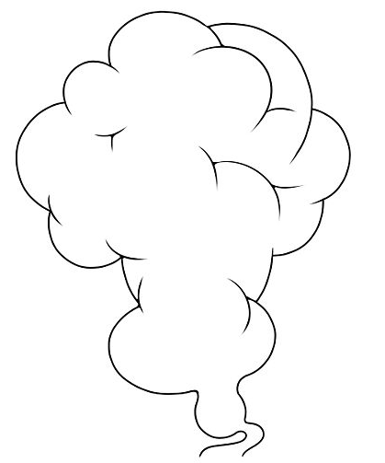


Meet
‘Smoky
Sam’
Notes:
Teacher Notes
Introduction to Smokey Sam
Meet Smokey Sam. He’s a young person just like you. He’s just recently started smoking.
He doesn’t know much about smoking, but some of his friends at school are doing it and some of his family as well. So he thinks it can’t really be a big deal.
He’s been smoking for weeks now and he’s started noticing some side effects.

Slide 7

How does smoking affect my body?
Notes:
Teacher Notes
Although Sam has heard from different people and on the TV that smoking is really bad for his health.
He has no idea how smoking really affects his health and his body.
We’re going to look at what might happen to Sam if he continues to smoke, how it will affect his body and what might happen to his health.

Slide 8

Notes:
Teacher Notes
Click on the different parts of Sam’s body to discover how smoking can effect the body.
Work from the Head down to the Feet.
You may wish to have the teachers notes printed out to refer to while teaching

Slide 9

Skin loses elasticity
Skin looks tired and grey
Can get wrinkles younger
Notes:
Teacher Notes
When you smoke, it can damage the outside of your body also – your skin.
When we are young, our skin is plump and fresh looking. Over time when smoking, our skin loses colour and can become very dry and grey in colour. A smoker’s skin looks tired and it can make you get wrinkles much younger than you should. This can make smokers look much older than you really are.

Slide 10

The brain becomes addicted to the chemicals and this causes cravings. It can be very difficult to overcome these cravings when you try to stop smoking
Smelly hair
Notes:
Teacher Notes
Cigarette smoke gets everywhere. It has a very strong smell, which lingers and is very hard to get rid of. Even with washing/shampoo the smell of cigarette smoke is very difficult to get rid of.
Smoking affects the brain too. Cigarettes contain a drug called nicotine. This drug is very addictive and that’s why some people find it difficult to stop.

Slide 11

Yellow teeth
Damages your gums
Loss of taste
Bad breath
Notes:
Teacher Notes
When people smoke, all the chemicals get into their body through their mouth. All those nasty ingredients found in cigarettes come into contact with our mouth and teeth and they can cause lots of damage.
Would you want to have yellow teeth/bad breath?
Did you know that when your gums become damaged, it makes your teeth more likely to fall out?
Could you imagine not being able to taste your food properly? How would you enjoy your dinner?

Slide 12


The more cigarettes smoked each day, the greater chances of having serious health problems
Poor blood circulation causing long term health problems
Notes:
Teacher Notes
Carbon Monoxide (CO) is a very dangerous ingredient found in cigarettes. It damages our cells and can stop our blood flow from carrying oxygen around our bodies. We need blood flowing fast all around our body for oxygen and nutrients to keep us alert, energetic and strong. Without this we can feel tired, weak and quite unwell.

Slide 13

Cuts and bruises can heal slower
Notes:
Teacher Notes
Smoking stops our body from getting all the good stuff from our food, all the vitamins/nutrients that we need to stay strong and well.
Smoking affects our absorption of Vitamin C from the foods we eat. Vitamin C is essential for healing and staying healthy. Smoking can stop cuts and bruises healing or getting better as quickly as possible.

Slide 14

Finger nails turn yellow
Notes:
Teacher Notes
A nasty ingredient in cigarettes called tar causes the finger nails to turn yellow. It’s very difficult to wash off.

Slide 15
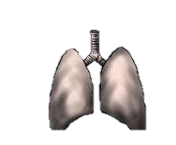

The longer he smokes the greater the health problems
Lung damage
Difficulty Breathing
Lung cancer
Risk of asthma
Notes:
Teacher Notes
How often do we breath? Every second of every day. That’s a lot of breaths! Imagine if you couldn’t breathe as well as you can now in Yr 6.
Damage to your lungs can often be the first side effect of smoking. You can get a wheezy cough and fell unwell.
**Activity 2** (Straws required)
Show your pupils how lung size can decrease when you smoke. Ask pupils to take a deep breath and hold for 3 seconds, then exhale. Hand out one straw per pupil. Take a deep breath through the straw, hold for 3 seconds and exhale through the straw again. Breathing through the straw demonstrates what it would be like to breathe if you were a smoker.
Are any of you involved in sports/teams/athletics? Imagine how much harder it would be to train or compete when you couldn’t breath freely.

Slide 16
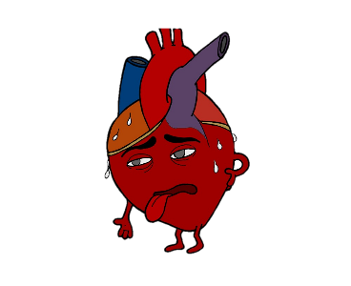

Damages your heart
Muscles can weaken
Low energy
Notes:
Teacher Notes
One big issue when it comes to smoking is how it damages your heart.
When we smoke, it causes large amounts of the dangerous gas Carbon Monoxide (CO) to enter into our blood. CO can stop your blood from carrying the oxygen that we need around your body.
Your heart is so important for our bodies to live, move and keep healthy. When blood cannot flow around our body easily, our heart has to work even harder to pump more blood all around the different parts of our body.
With all this extra work for the heart to do, it can become tired and weak. After a while our heart gets injured and doesn’t work like it should. The whole body can feel tired and will not be able to function as well as it should do.
As we know smoking can have an effect on bringing oxygen around your body. When our body has less oxygen going to our muscles, they can get weak and you feel like you have no energy. Imagine if you had no energy to go to school every day, to play with your friends and to go to the cinema at the weekend!

Slide 17
Cigarette smoke makes
clothes
stink
The smell on the body and clothes disappears within a couple of days of stopping smoking
Notes:
Teacher Notes
Cigarette smoke gets everywhere! It makes clothes, shoes and hair stink.
It’s horrible and really hard to get rid of. Even when you wash your clothes/ use deodorant/ perfume the smokey smell is really hard to get rid of.
Often people who smoke don’t realise that their clothes smell and the smell stays on longer after a cigarette is finished.
**Activity 1** Bring in a smokers item of clothing to show the class how cigarette smoke really smells and stay on your clothes.

Slide 18

When someone gives up smoking their energy levels can increase again within a couple of days
Notes:
Teacher Notes
Giving up smoking is the best thing a smoker can do to improve their health.

Slide 19



Effects of Stopping Smoking
Few
Hours
Blood pressure and pulse return to normal
1-2
Days
Carbon Monoxide and Nicotine have left the body and lungs start to clear. The sense of taste starts to improve
3
Days
Can breathe more easily and have more energy
Notes:
Teachers notes
A smoker’s health improves after they have stopped smoking.
In addition, from 2-12 weeks blood circulation improves; within 3-9 months coughing, wheezing and breathing problems get better the lungs recover and risk of heart attack is half that of a smoker within one year.

Slide 20
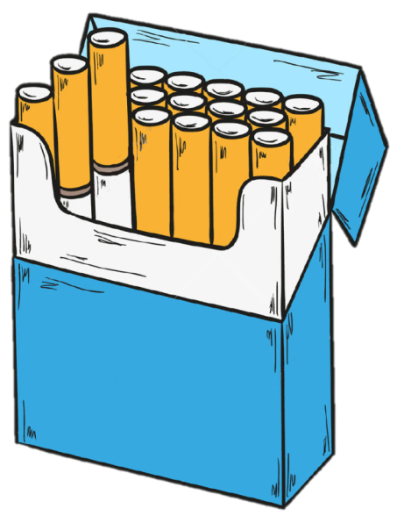
Cost of Smoking
£9
X by number of days they have stopped smoking to find savings
1 pack = 20 cigarettes
Notes:
Teachers notes
Week one
One of the benefits from stopping smoking is saving money. Smoking is very expensive and sometimes people who smoke forget how much they could save or could buy nice new things instead of spending money on cigarettes.
**Activity 3** - Activity sheet in pack
Work out how much money your quitter will save from stopping smoking in a day, 2 days, 1 week, 1 month, 6 months and 1 year.
20 pack cigarettes equals £9. Ask them how many cigarettes they smoke a day, it may be less than or more than 20 cigarettes a day.
(Activity sheet in your pack)
Include this information in the first letter of support.

Slide 21

Mission 2
Identify and support a member of your community who wants to stop smoking

Slide 22

Millions of smokers have successfully quit
There is a smoker in your community who you could help to stop smoking
Notes:
Teachers notes
With good support smokers can quadruple their chances of success.

Slide 23


What we will be doing?
Identify 2-3 people who want to stop
Get your teacher to ask them would they like our support
During their 1st month we will offer encouragement and motivation to help/support them to stop smoking
Find out all about them
Invite them into your classroom
Send them a questionnaire
Notes:
Teachers notes
Do any of you know someone who smokes? Do they want to quit? Would they be up for the challenge in trying to stop smoking with our help? We, as members of Smokebusters will help a member of our local community.
See slide 29 for possible questions to ask them or to put in a questionnaire.

Slide 24
Timescale - Guide
Find your ‘Stop Smoking Champions’
Find out about their smoking habit – either in your classroom or using our questionnaire
Begin to prepare the letters of support which you will send to them (lots of suggestions in the next slides)
Forward Support Letter No. 1
Forward Support Letter No. 2
Week 1
Week 2
Week 3
Week 4
Week 5
Notes:
Teachers notes
Once we have ‘Stop Smoking Champion/s’ who want to quit smoking, we are going to help them by sending them a message of support every week for four weeks either by letter or face to face in our classroom.
Guidance about support letters given from slide 30.

Slide 25
Timescale – Guide (Continued)
Forward Support Letter No. 3
Forward Support Letter No. 4
Forward Support Letter No. 5
Nominate Your ‘Stop Smoking Champion’ for an award
Week 6
Week 7
Week 8
Week 9
Notes:
Teachers notes
Guidance about support letters given from slide 30.

Slide 26


Let’s get started!
Are you going to make a real difference to someone in your community? You might save lives!
Notes:
Teachers notes
Remember we can succeed if we support people but we should never ‘nag’ a smoker. Encourage people to stop smoking using positive messages. E.g. how their health has improved or how much money they have saved.

Slide 27

Finding your local smokers who want to ‘quit’
Who? Someone in your school, town, local area who wants to stop smoking
How will you find them?
Ask in school, at home etc.
Notes:
Teachers notes
Nominate your Stop Smoking Champion (quitter). Maybe a teacher/cleaner/other staff member in the school, parent, local business man/women or member of the local council. Identify 2-3 quitters as not all smokers will succeed in their quit attempt.
Contact us if required (smokebusters@cancerfocusni.org)
Find more info on www.want2stop.info

Slide 28

Finding out about your
‘Stop Smoking Champions’
Interview your champion or send them out a questionnaire to find out information about their smoking habits
You will be using the information that they give you to help them to stop smoking
Notes:
Teachers notes
Use the questionnaire on slide 29.

Slide 29
Questions to ask your
‘Stop Smoking Champion’
How long have you been a smoker?
How many cigarettes do you smoke per day?
Have you tried to stop before?
How hard was it to stop?
Why did you not succeed/give up?
Why are you stopping smoking now?
How can we help?
Do you smoke in your home or around other people?
Notes:
Teachers notes
From Week 2 of your timescale guide ask the smoker to answer some important questions about their habit. Their answers will help your pupils support them appropriately. Invite them into your classroom or send them a letter to ask the questions.

Slide 30
Support Letter No 1
(send by Week 4)
Things to include in your letter to your champion:
Tell them how fantastic they are to take on this challenge and that your whole class are behind them.
Tell them that they can do it. They may need to find a way to overcome the cravings and to stay away from places where they usually smoke
Remind them of why they wanted to stop smoking and encourage them to stay off them
Notes:
Teacher notes
Either by post or in person deliver this information to the quitter.

Slide 31

Support Letter No 2
(send by Week 5)
Things to include in your letter to your champion:
How pleased you are that they have managed to stay off cigarettes for 7 whole days
How much money they have saved in 1 week without cigarettes
Remind them of why they wanted to stop smoking and encourage them to stay off them
Remind them that they will have already stopped smelling of cigarette smoke
Notes:
Teacher notes
Either by post or in person deliver this information to the quitter.

Slide 32
Support Letter No 3
(send by Week 6)
Things to include in your letter to your champion:
Congratulate them on being smoke-free for 14 days
Tell them how they are your champion and how proud you are of them
Tell them how much money they have saved after 14 days without cigarettes
Let them know of the changes which have already happened in their body having stopped for 14 days (already nicotine and carbon monoxide will have left their body and their blood pressure and pulse will have returned to normal levels.)
Encourage them to keep going!
Notes:
Teacher notes
Either by post or in person deliver this information to the quitter.

Slide 33

Support Letter No 4
(send by Week 7)
Things to include in your letter to your champion:
Congratulate them for being smoke-free for 21 days
Advise them to resist the cravings by focussing on why they want to stop.
Tell them how much money they have saved after 21 days without cigarettes
Tell them that their breath, clothes and hair have stopped smelling
Remind them how much better they can taste food now that they have quit smoking
Let them know of all the health benefits which have occurred and all the changes which have happened in their body
Notes:
Teacher notes
Either by post or in person deliver this information to the quitter.

Slide 34
Support Letter No 5
(send by Week 8)
Things to include in your letter to your champion:
Congratulate them for being smoke-free for 28 days and let them know that they are now 5 times more likely to stay stopped for good!
Tell them how much money they have saved after 28 days without cigarettes. Calculate how much they will save in a year / 10 years.
Tell them how their family and friends are all much healthier too, now that they are not breathing in cigarette smoke
Let them know that you are going to nominate them to Cancer Focus NI as ‘Stop Smoking Champion of the Year!’
Notes:
Teacher notes
Either by post or in person deliver this information to the quitter.
If your quitter has relapsed, they can keep going. This happens to some people who are trying to quit. Follow this link for info on how to get back on track: http://www.want2stop.info/ready-stop-smoking/what-if-i-relapse

Slide 35
If at any stage they relapse…
Tell them they’ve had some success and can succeed fully next time
Encourage them to start again
Reassure them that they will succeed the next time

Slide 36



Name:
You have stopped smoking for 28 days!
Congratulations from:
Smokebusters Club Members
X
Notes:
Teachers notes
Stop Smoking Champion (Quitter) Certificate. Please add the name of the quitter and the name of the school.
Why not invite your Stop Smoking Champion to your classroom or school assembly and ask them to say a few words. Make them an honorary Smokebusters member.

Slide 37
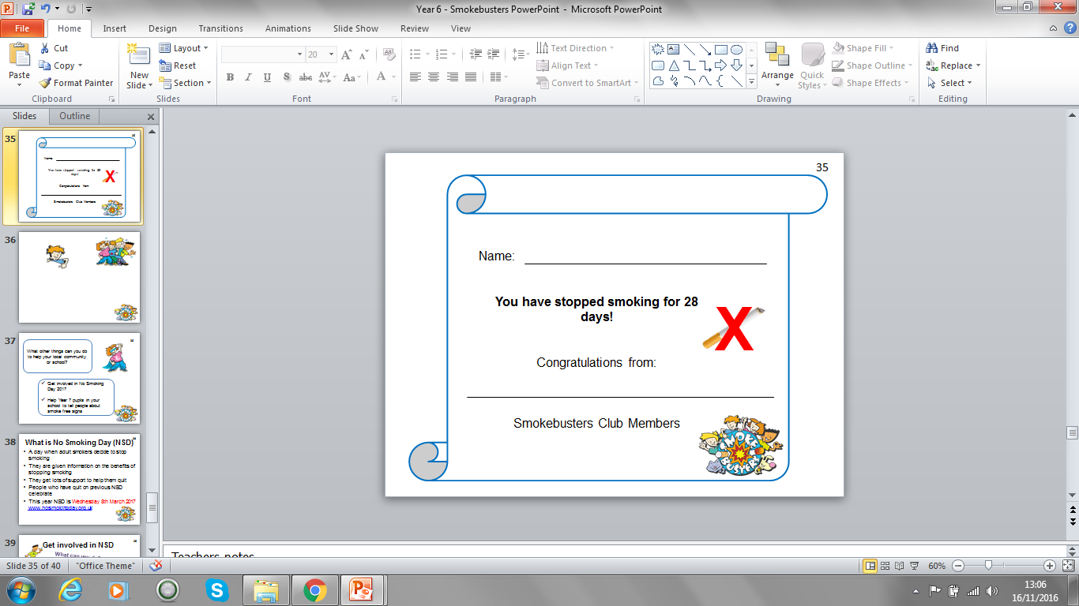

Invite your ‘Stop Smoking Champion’ to your school and present them with their certificate
Well done!
You did it!
3 big cheers!
Notes:
Teacher notes
Invite your ‘Stop Smoking Champion’ to the school assembly or into the classroom. The pupils can present them with their certificate and give their own personal messages of congratulations.

Slide 38

What other things can you do to help your local community or school?
39
Get involved in No Smoking Day (14th March 2018)
Help Year 7 pupils in your school to tell people about smoke free signs

Slide 39

What is No Smoking Day (NSD)
A day when adult smokers decide to stop smoking
They are given information on the benefits of stopping smoking
They get lots of support to help them quit
People who have quit on previous NSD celebrate
This year NSD is Wednesday 14th March 2018
Notes:
Teachers notes
It is a day when adult smokers are reminded of the benefits of stopping smoking. They are also encouraged to stop smoking for that day or to stop smoking for good. People who want to stop smoking are given information on where to find help to quit. It is very a successful campaign in Northern Ireland. (www.nosmokingday.org.uk)

Slide 40

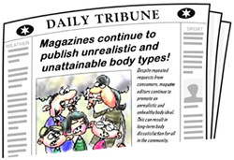




Get involved in
No Smoking Day
Go viral
Research websites/organisations who support NSD. Ask your school to retweet and share their messages about NSD
Make posters and display them in your school. Ask local shops to display your posters or ask your school to upload them onto their website, Facebook and Twitter pages
Notes:
Teachers notes
No Smoking Day is a national campaign which has existed for over thirty years. It always takes place on the second Wednesday in March. Find information and resources on www.nosmokingday.org.uk

Slide 41

Smoke-free signs at school
Do you know what year 7 pupils are doing?
Can you help them?

