Slide 1
Year 7

Slide 2
Learning Outcomes
Mission 1: Know Your Enemy (delivered by Cancer Focus NI Officer)
Help expose the tobacco industry’s tactics to recruit young smokers.
Mission 2 : Self Defence (delivered by Cancer Focus NI Officer)
Practise how to say ‘no’ to cigarettes.
Mission 3: Fact Finding (Teacher-led)
Learn about the chemicals in a cigarette and the dangers of second-hand smoke.
Mission 4 : Take Action (Teacher-led)
We want you to campaign and ask our Health Minister and our Assembly members to ban smoking in cars.
Notes:
Teachers notes
You may have had a visit from one of our Cancer Focus officers, who delivered Mission 1 and 2, however today we are going to learn about Mission 3 and 4
Mission 4: Take Action
We want to say a huge congratulations to last years Smokebusters who campaigned for a ban on smoking in cars. We also want to thank the Health Minister for announcing that it would happen however we are still waiting for this law to be approved in Northern Ireland. This year we want Smokebusters to campaign and ask the Health Minister and our Assembly members to set a date in 2017 for this ban on smoking in cars.

Slide 3
Mission 3
Fact Finding
Learn about the chemicals in a cigarette and the dangers of second-hand smoke.

Slide 4
What is in a cigarette?
Notes:
Sam has started to wonder what must be in a cigarette that is starting to make him feel not too good.
Is it just a piece of paper? Do they contain chemicals? What’s really in a cigarette

Slide 5
Smoky
Sam
Notes:
Teacher Notes
Introduction to Smokey Sam
Meet Smokey Sam. He’s a boy who has just recently started smoking.
He doesn’t know much about smoking, but some of his friends at school are doing it and some of his family as well. So he thinks it can’t really be a big deal.
He has been smoking for weeks now and has started noticing some side effects

Slide 6
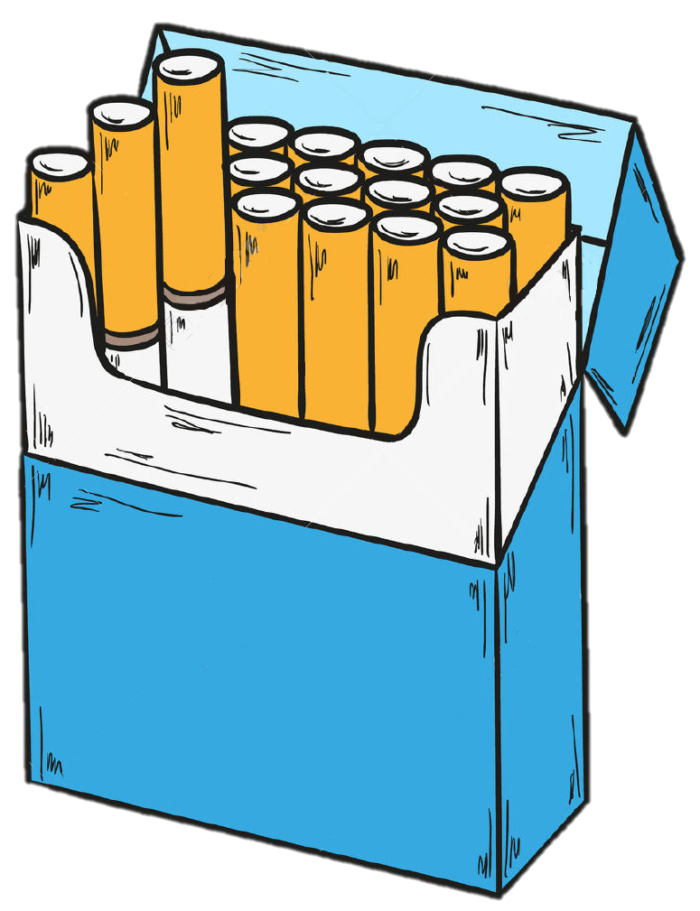
FACT
There are over
4000 chemicals
in cigarette smoke
Notes:
There are actually over 4000 chemicals in a single cigarette! Some of these chemicals are extremely dangerous and easily damage our health.
Does anyone want to take a guess at what might be found in cigarettes? It is not easy to guess because the tobacco companies like to keep this a secret and only have to list three on the side of the pack.

Slide 7
Cigarette Factory
Notes:
In this first exercise we are going to a cigarette factory to take a look at some of those nasty chemicals they use in cigarettes.
We are going to venture into the store cupboard!

Slide 8
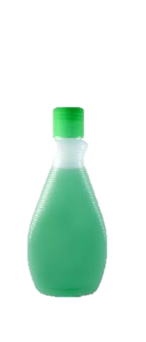
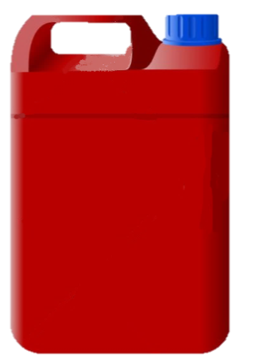
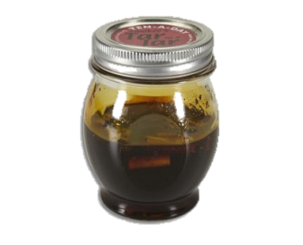
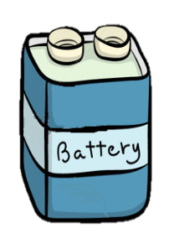
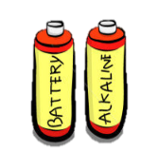

Slide 9
Methanol
Found in rocket fuel

Slide 11
Carbon Monoxide
Found in car exhaust fumes
A poison that replaces oxygen in blood
Causes difficulty breathing

Slide 13
Arsenic
Used in rat poison
Deadly poison that causes cancer
Makes you vomit, feel nauseous, weak and shaky.

Slide 15
Butane
Used in lighter fuel
Highly flammable
Causes dizziness and difficulty breathing

Slide 17
Acetone
Found in nail polish/paint remover
Affects the nervous system

Slide 19
Cadmium
Used in batteries
Damages lungs, kidney and brain

Slide 21
Nicotine
The drug found in cigarettes
Affects chemicals in the brain, this is why it is so addictive.

Slide 23
Ammonia
Used in cleaning products
Increases the absorption of nicotine
Keeps you addicted

Slide 25
Tar
Similar to tar found on roads
Found in tobacco smoke
Coats the lungs causing damage

Slide 27
Why it’s better to be smoke-free
Notes:
Why its better to be smoke free:
https://www.youtube.com/watch?v=hCC1dgmwO_4

Slide 28
Mission 2
Self Defence
Practice how to say no to cigarettes

Slide 29
There are 4 main approaches to say NO to smoking
Use information about the dangers of smoking to get them to stop
Just refuse and walk away
Change the subject - talk about something else
Use humour to take the pressure off the situation

Slide 30
Let’s look at what these actually look like in real life situations.

Slide 31
Using Humour

Slide 32
Using Humour
Could you use this in a situation if you were being asked by a friend or someone you know to smoke?

Slide 33
Changing the Subject

Slide 34
Changing the Subject
Is this an approach you could see yourself using in real life?

Slide 35
Refuse and Walk Away

Slide 36
Any other ideas?
Why is it NOT OK to become angry, snatch the cigarette off them and destroy it?

Slide 37
Warning About The Dangers

Slide 38
Thinking Time!
What other approaches might you use which we have not suggested?

Slide 39
Which is the most popular choice in this P7 class?
It is important to use whichever method you feel comfortable with and what will work best for you.
Remember!

Slide 40
Roleplay Activity Instructions
Get into groups of 4, make each member either person A/B
A: Try to persuade Person B to smoke
B: Use your defence skills to say no to smoking
Change places so that each person gets a chance to practice refusing and saying ‘no’.
Notes:
Do you remember carrying out the roleplay activities?

Slide 41
Roleplay
Activity
You are at the cinema for your friend’s birthday party. The movie is over and everyone is waiting outside for their parents to come and collect them. One of your older friends starts to smoke and offers a cigarette. You want to feel grown up and fit in, however you still want to say ‘no’.
How do you say ‘no’?

Slide 42
Roleplay
Activity
You are now in Year 8 in secondary school and it is the end of the school day and you and your friends are waiting at the bus stop. One of your friends takes out a packet of cigarettes and offers you one. You’re afraid you will be left out and your friends will think you’re not cool. However, you still don’t want to smoke.
How do you say ‘no’?

Slide 43
One of the reasons to stay smoke-free is so you don’t hurt others around you
But how does smoking
hurt people
that don’t smoke
cigarettes?
It happens because of second-hand smoke

Slide 44
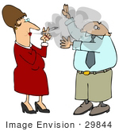
Second-Hand Smoke
Question
What is it?
Answer
It is when we breathe in someone else’s cigarette smoke.

Slide 45
So, even if you don’t smoke, you have to be aware of second-hand smoke!
We need to protect
ourselves from
second-hand smoke
wherever we are

Slide 46
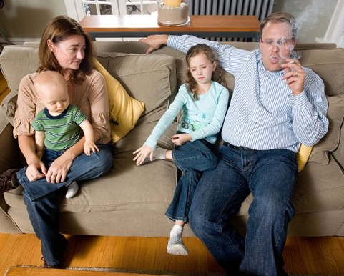
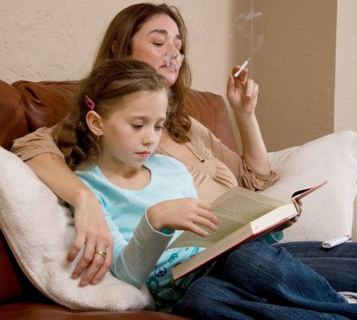
There can be second-hand smoke at home
Notes:
Because children may still be exposed to smoke at home, young people can still be at risk.

Slide 47
Second-hand smoke can also be found in the car

Slide 48
Why smoking in cars is dangerous to young people
Children have
smaller lungs, faster
breathing and less
developed
immune systems
Children who breathe
in second-hand smoke
can have more lung /ear
infections and asthma
attacks
Smoking in the
car is extremely dangerous because smoke and toxic chemicals can reach very high levels
in a small enclosed space
Notes:
Teacher’s notes
From the 1st October 2015, smoking in cars carrying children was banned in England and Wales. However, in Northern Ireland smoking was still allowed in cars carrying young children. Last year all Smokebuster members joined forces and wrote to the Health Minister for a ban on smoking in cars carrying young children in Northern Ireland.
Whats happening in NI now…current???
https://www.youtube.com/watch?v=gcMGrVxo0Wo

Slide 49
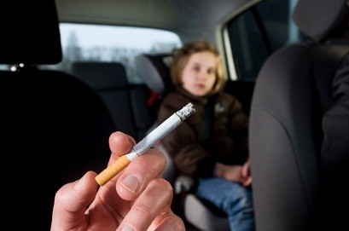
Last year Smokebuster members campaigned for a ban on smoking in cars
Well done!
We are waiting for this law to happen in N.Ireland
Notes:
A law to ban smoking in cars carrying children has came into effect in England and Wales. We want the same in Northern Ireland so last year Smokebuster members wrote 1000’s of letters to the health minister asking to ban smoking in cars carrying children within NI. As a result of this we are waiting for this law to be approved.

Slide 50
This year you will ask the Health Minister to set a date in 2018 for the ban on smoking in cars.
In Mission 4 we will
give you information about how you will do this

Slide 51
Mission 4
Take Action
We want you to campaign and ask our Health Minister and our Assembly members to set a date in 2018 for the ban on smoking in cars

Slide 52
Remember we need to:
Campaign for a tobacco-free Northern Ireland

Slide 53
We need you!
You are
all very
important

Slide 54
The ban on smoking in cars carrying young children has not happened yet within Northern Ireland
We need your help to ask our Health Minister to set a date in 2017 for the ban on smoking in cars
You need to protect yourselves from second-hand smoke

Slide 55
We are going to sign a petition to ask our Health Minister and assembly members for a date in 2018 for the ban on smoking in cars to happen
Petition
A formal message written to someone in charge asking for the law to be changed
Smokebuster clubs in Northern Ireland will sign the petition

Slide 56
Our Smokebusters Petition will look like this
Smokebusters urge politicians to “Protect our health”
Our Smokebusters (NI) Pledge states:
“I promise to campaign for a tobacco-free Northern Ireland”
We the Yr 6 / Yr 7 pupils of
__________________________________________ (School name)
urge our Health Minister to protect us from second-hand smoke, by setting a date for banning smoking in cars.
I sign on behalf of the pupils in my class (Teacher name)

Slide 57
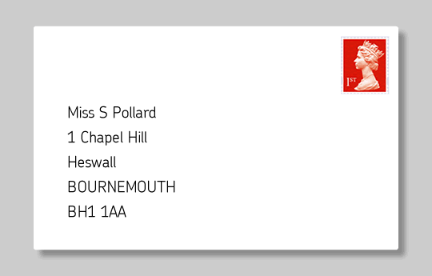
Activity No.1 Get your teacher to sign it now on your behalf and return to Cancer Focus NI HQ
Smokebusters Club NI
Cancer Focus Northern Ireland
40-44 Eglantine Ave.
Belfast
BT9 6DX
Make sure that you return your petition no later than Wednesday 11th May 2018
Notes:
See Activity Sheet No. 5

Slide 58
Smokebusters HQ will forward your petition to our Health Minister
Stormont
This is where politicians make
Northern Ireland’s
BIG decisions
Notes:
We will present it to the Public Health Agency asking them to provide more signage for school gates.

Slide 59
Contact your local council/MLA and invite them to your school assembly to tell them what you are doing.
Other great things to do…
Ask them to Tweet/Facebook about what you are doing and to get other people to support your campaign

Slide 60
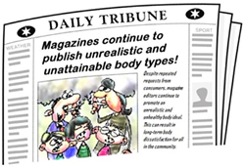
Send a letter and pictures to your local newspaper, letting them know what Smokebusters are doing in school
Schools ask for date from Health Minister

Slide 61
Make your message go VIRAL!
You could use:
Facebook
Twitter
BBC/UTV

Slide 62
Contact other Smokebusters clubs in your area and find out what they are doing
Contact Cancer Focus NI to locate your nearest Smokebusters school

Slide 63
Congratulations!
You have now completed all of your Smokebusters Missions
Your training
is now
complete!

Slide 64
Well Done!
Year 7

