Slide 1





Year 7

Slide 2


Learning Outcomes
Mission 1: Know Your Enemy (delivered by Cancer Focus NI Officer)
Help expose the tobacco industry’s tactics to recruit young smokers.
Mission 2 : Self Defence (delivered by Cancer Focus NI Officer)
Practise how to say ‘no’ to cigarettes.
Mission 3: Fact Finding (Teacher-led)
Learn about the chemicals in a cigarette and the dangers of second-hand smoke.
Mission 4 : Take Action (Teacher-led)
We want you to campaign and ask our Health Minister and our Assembly members to ban smoking in cars.
Notes:
Teachers notes
You may have had a visit from one of our Cancer Focus officers, who delivered Mission 1 and 2, however today we are going to learn about Mission 3 and 4
Mission 4: Take Action
We want to say a huge congratulations to last years Smokebusters who campaigned for a ban on smoking in cars. We also want to thank the Health Minister for announcing that it would happen however we are still waiting for this law to be approved in Northern Ireland. This year we want Smokebusters to campaign and ask the Health Minister and our Assembly members to set a date in 2017 for this ban on smoking in cars.

Slide 3


Mission 3
Fact Finding
Learn about the chemicals in a cigarette and the dangers of second-hand smoke.

Slide 4



Smoky
Sam
Notes:
Teacher Notes
Introduction to Smokey Sam
Meet Smokey Sam. He’s a boy who has just recently started smoking.
He doesn’t know much about smoking, but some of his friends at school are doing it and some of his family as well. So he thinks it can’t really be a big deal.
He has been smoking for weeks now and has started noticing some side effects

Slide 5

What is in a cigarette?
Notes:
Sam has started to wonder what must be in a cigarette that is starting to make him feel not too good.
Is it just a piece of paper? Do they contain chemicals? What’s really in a cigarette

Slide 6
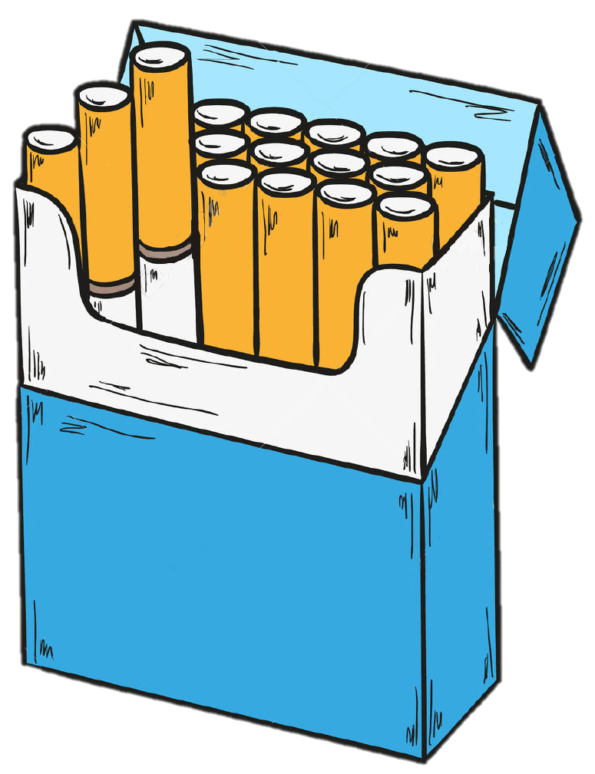
FACT
There are over
4000 chemicals
in cigarette smoke
Notes:
There are actually over 4000 chemicals in a single cigarette! Some of these chemicals are extremely dangerous and easily damage our health.
Does anyone want to take a guess at what might be found in cigarettes? It is not easy to guess because the tobacco companies like to keep this a secret and only have to list three on the side of the pack.

Slide 7


Cigarette Factory
Notes:
In this first exercise we are going to a cigarette factory to take a look at some of those nasty chemicals they use in cigarettes.
We are going to venture into the store cupboard!

Slide 8
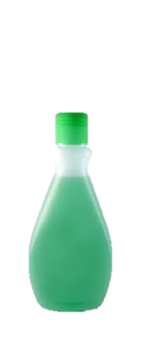









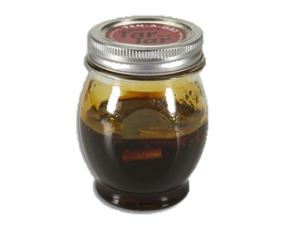

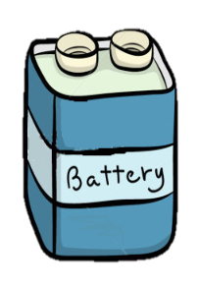

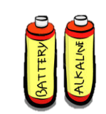

Slide 9

Methanol
Found in rocket fuel

Slide 10


Slide 11

Carbon Monoxide
Found in car exhaust fumes
A poison that replaces oxygen in blood
Causes difficulty breathing

Slide 12


Slide 13
Arsenic
Used in rat poison
Deadly poison that causes cancer
Makes you vomit, feel nauseous, weak and shaky.

Slide 14



Slide 15

Butane
Used in lighter fuel
Highly flammable
Causes dizziness and difficulty breathing

Slide 16


Slide 17

Acetone
Found in nail polish/paint remover
Affects the nervous system

Slide 18


Slide 19

Cadmium
Used in batteries
Damages lungs, kidney and brain

Slide 20


Slide 21


Nicotine
The drug found in cigarettes
Affects chemicals in the brain, this is why it is so addictive.

Slide 22


Slide 23

Ammonia
Used in cleaning products
Increases the absorption of nicotine
Keeps you addicted

Slide 24


Slide 25

Tar
Similar to tar found on roads
Found in tobacco smoke
Coats the lungs causing damage

Slide 26


Slide 27


Why it’s better to be smoke-free
Notes:
Why its better to be smoke free:
https://www.youtube.com/watch?v=hCC1dgmwO_4

Slide 28


One of the reasons to stay smoke-free is so you don’t hurt others around you
But how does smoking
hurt people
that don’t smoke
cigarettes?
It happens because of second-hand smoke

Slide 29
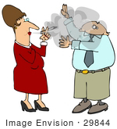

Second-Hand Smoke
Question
What is it?
Answer
It is when we breathe in someone else’s cigarette smoke.

Slide 30


So, even if you don’t smoke, you have to be aware of second-hand smoke!
We need to protect
ourselves from
second-hand smoke
wherever we are

Slide 31
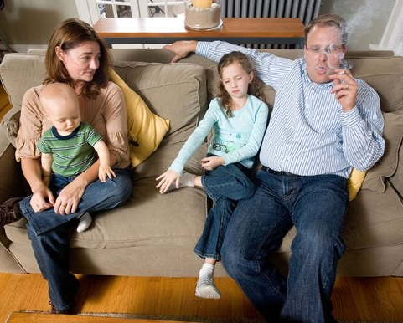



There can be second-hand smoke at home
Notes:
Because children may still be exposed to smoke at home, young people can still be at risk.

Slide 32

Second-hand smoke can also be found in the car

Slide 33





Why smoking in cars is dangerous to young people
Children have
smaller lungs, faster
breathing and less
developed
immune systems
Children who breathe
in second-hand smoke
can have more lung /ear
infections and asthma
attacks
Smoking in the
car is extremely dangerous because smoke and toxic chemicals can reach very high levels
in a small enclosed space
Notes:
Teacher’s notes
From the 1st October 2015, smoking in cars carrying children was banned in England and Wales. However, in Northern Ireland smoking was still allowed in cars carrying young children. Last year all Smokebuster members joined forces and wrote to the Health Minister for a ban on smoking in cars carrying young children in Northern Ireland.
Whats happening in NI now…current???
https://www.youtube.com/watch?v=gcMGrVxo0Wo

Slide 34
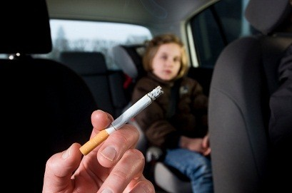


Last year Smokebuster members campaigned for a ban on smoking in cars
Well done!
We are waiting for this law to happen in N.Ireland
Notes:
A law to ban smoking in cars carrying children has came into effect in England and Wales. We want the same in Northern Ireland so last year Smokebuster members wrote 1000’s of letters to the health minister asking to ban smoking in cars carrying children within NI. As a result of this we are waiting for this law to be approved.

Slide 35




This year you will ask the Health Minister to set a date in 2017 for the ban on smoking in cars.
In Mission 4 we will
give you information about how you will do this

Slide 36

Mission 4
Take Action
We want you to campaign and ask our Health Minister and our Assembly members to set a date in 2017 for the ban on smoking in cars

Slide 37



Remember we need to:
Campaign for a tobacco-free Northern Ireland

Slide 38

We need you!
You are
all very
important

Slide 39

The ban on smoking in cars carrying young children has not happened yet within Northern Ireland
We need your help to ask our Health Minister to set a date in 2017 for the ban on smoking in cars
You need to protect yourselves from second-hand smoke

Slide 40



We are going to sign a petition to ask our Health Minister and assembly members for a date in 2017 for the ban on smoking in cars to happen
Petition
A formal message written to someone in charge asking for the law to be changed
Smokebuster clubs in Northern Ireland will sign the petition

Slide 41


Our Smokebusters Petition will look like this
Smokebusters urge politicians to “Protect our health”
Our Smokebusters (NI) Pledge states:
“I promise to campaign for a tobacco-free Northern Ireland”
We the Yr 6 / Yr 7 pupils of
__________________________________________ (School name)
urge our Health Minister to protect us from second-hand smoke, by setting a date for banning smoking in cars.
I sign on behalf of the pupils in my class
(Teacher name)

Slide 42
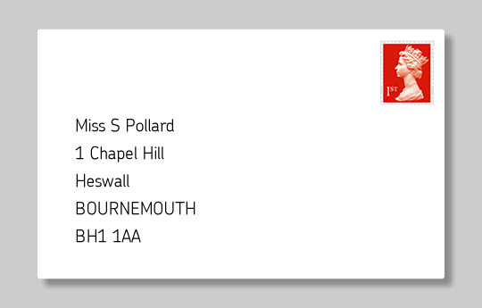


Activity No.1
Get your teacher to sign it now on your behalf and return to Cancer Focus NI HQ
Smokebusters Club NI
Cancer Focus Northern Ireland
40-44 Eglantine Ave.
Belfast
BT9 6DX
Make sure that you return your petition no later than Wednesday 10th May 2017
Notes:
See Activity Sheet No. 5

Slide 43



Smokebusters HQ will forward your petition to our Health Minister
Stormont
This is where politicians make
Northern Ireland’s
BIG decisions
Notes:
We will present it to the Public Health Agency asking them to provide more signage for school gates.

Slide 44

Contact your local council/MLA and invite them to your school assembly to tell them what you are doing.
Other great things to do…
Ask them to Tweet/Facebook about what you are doing and to get other people to support your campaign

Slide 45

Send a letter and pictures to your local newspaper, letting them know what Smokebusters are doing in school
Schools ask for date from Health Minister

Slide 46





Make your message go VIRAL!
You could use:
Facebook
Twitter
BBC/UTV

Slide 47


Contact other Smokebusters clubs in your area and find out what they are doing
Contact Cancer Focus NI to locate your nearest Smokebusters school

Slide 48
Congratulations!
You have now completed all of your Smokebusters Missions
Your training
is now
complete!

Slide 49


Well Done!
Year 7

