Slide 1
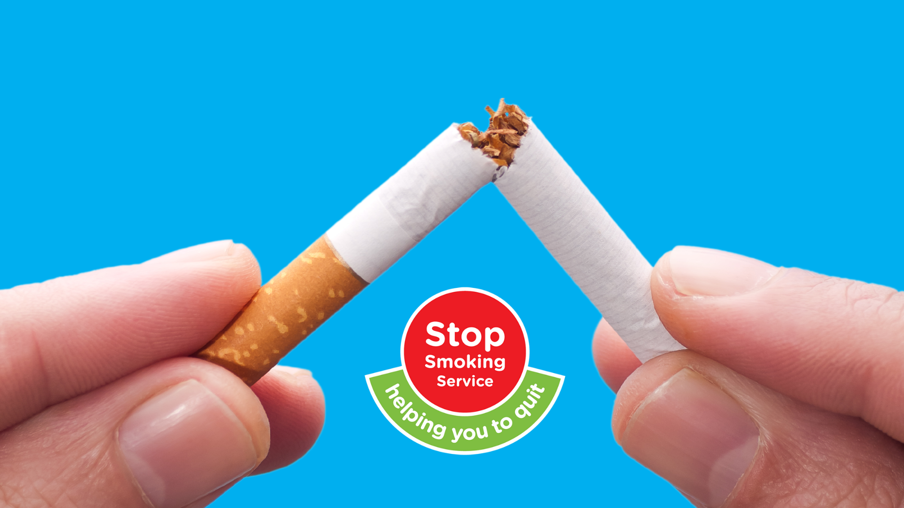
#NoSmokingMonth
Make March Your Month to Quit
Communications Toolkit
March 2025

Slide 2
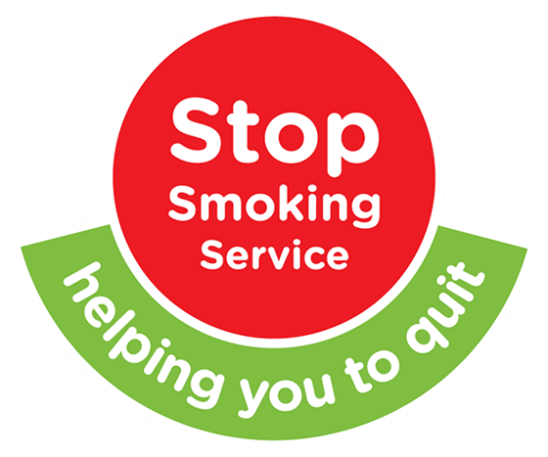
No Smoking Month 2025
Communications Toolkit
Purpose
This document provides an overview of the No Smoking Month campaign for March 2025.
This aid is to help Trusts, GP practices and pharmacies, Councils, Community Champions (eg. Healthy Living Centres) and those managing relevant social media accounts to lead on their own locally led campaigns to engage with smokers in a coordinated and cohesive approach during the month of March.
The purpose of the month is to:
Raise awareness and highlight the health implications of smoking tobacco for both smokers and those who regularly spend time with smokers, such as family and friends.
Encourage smokers to take that first step towards quitting smoking.
Highlight the many benefits associated with giving up smoking.
Profile the people positively impacted by giving up smoking and the specialists who make the journey to abstinence successful.
Promote the available stop smoking services available across NI.

Slide 3
No Smoking Month 2025
Communications Toolkit
    No Smoking Month Themes
  A handy set of themes have been selected to help plan your activity throughout the month of March.
  You can use the themes most important to you, your work, and your local audiences. The important thing is to keep the momentum going across the month of March to reach as many people as possible with No Smoking messages.
  Available Services – what they are, what they do, how to access them.
  Meet The… - showcasing the people behind the services.
  General Health – highlighting the health benefits of quitting.
  Vaping – tackling vaping misconceptions.
  Mental Wellbeing – how smoking impacts anxiety and depression.
  Smoke Free Places – discouraging smoking in particular locations.
  Pregnancy & Children – smoke free pregnancies and households.
  Finances – detailing the savings to a smoker’s pocket.

Slide 4

No Smoking Month 2025
Communications Toolkit
Theme: Available Services
Suggested Social Media Messages:
Suggested Text | Suggested Media*
Needing help and support to quit smoking this #NoSmokingMonth? Free help is available across Northern Ireland to anyone wanting to start their #StopSmoking journey: https://www.stopsmokingni.info/
This March, [Insert Your Organisation Name] is supporting #NoSmokingMonth. If you’re interested in quitting smoking, there is free help and support available to help you along the way: https://vimeo.com/513360719 | https://vimeo.com/513360719
Needing help and support to quit smoking this #NoSmokingMonth? Free help is available across Northern Ireland to anyone wanting to start their #StopSmoking journey: https://www.stopsmokingni.info/
Did you know that your local #StopSmoking Service can be easily accessed through your Hospital/GP or Pharmacist? Matched with an expert adviser, this free service will increase your chances of kicking your smoking habit for good: https://www.stopsmokingni.info/
*Please see the Campaign Assets Library to download the ready-to-use social media images/videos to accompany the posts.
Alternatively, create something bespoke to your own social media channels.

Slide 5
No Smoking Month 2025
Communications Toolkit
Theme: Meet the…Stop Smoking Specialists
Suggested Social Media Messages:
Suggested Text | Suggested Media*
This #NoSmokingMonth, meet some of the #StopSmoking specialists offering free support throughout Northern Ireland to people wishing to kick their nicotine habit: https://youtu.be/p9QFOia0Zss | https://youtu.be/p9QFOia0Zss
Across NI, trained #StopSmoking specialists are at hand to help you #StopSmoking. This #NoSmokingMonth, connect with an expert and begin your journey to being smoke free. https://youtu.be/p9QFOia0Zss | https://youtu.be/p9QFOia0Zss
Do you want to stop smoking? Across Northern Ireland, there are around 500 stop smoking services with specialists who want to help and support you if you wish to quit smoking. Meet them: https://youtu.be/p9QFOia0Zss | https://youtu.be/p9QFOia0Zss
*Please see the Campaign Assets Library to download the ready-to-use social media images/videos to accompany the posts.
Alternatively, create something bespoke to your own social media channels.

Slide 6

No Smoking Month 2025
Communications Toolkit
Theme: General Health
Suggested Social Media Messages:
Suggested Text | Suggested Media*
Your heart rate rises within one minute of starting to smoke. It could rise by as much as 30% within the first 10 minutes of smoking. You’re at an increased risk of developing cardiovascular disease even with light smoking. Make March your Month to Quit #StopSmokingNI
Lung cancer was almost unheard of before the smoking of manufactured cigarettes became popular. There are approximately 1000 lung cancer deaths in Northern Ireland each year. Of these, approximately 880 are caused by smoking. Make March your month to #StopSmoking.
Why quit? When burned, cigarettes create more than 7,000 damaging chemicals, many of which are proven to cause cancer and other serious illnesses. Learn more: https://www.stopsmokingni.info/why-quit/your-health
Gary's story. After taking up cycling Gary decided quitting cigarettes was the best thing he could do for his health. Learn more about how Gary quit smoking. https://www.stopsmokingni.info/success-stories/garys-story | https://www.stopsmokingni.info/success-stories/garys-story
*Please see the Campaign Assets Library to download the ready-to-use social media images/videos to accompany the posts.
Alternatively, create something bespoke to your own social media channels.

Slide 7
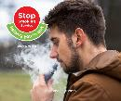

No Smoking Month 2025
Communications Toolkit
Theme: Vaping
Suggested Social Media Messages:
Suggested Text | Suggested Media*
The nicotine content of many disposable vapes is equivalent to a pack of 20 cigarettes. If you don’t smoke, don’t vape. #NoSmokingMonth
The law is changing. Disposable vapes are going to be banned so why not take this chance as your time to quit. #NoSmokingMonth
Stop vaping and reduce your impact on our local environment - no plastics, no poisons, no insecticides. #NoSmokingMonth
*Please see the Campaign Assets Library to download the ready-to-use social media images/videos to accompany the posts.
Alternatively, create something bespoke to your own social media channels.

Slide 8


No Smoking Month 2025
Communications Toolkit
Theme: Mental Wellbeing
Suggested Social Media Messages:
Suggested Text | Suggested Media*
Feeling anxious, depressed, or stressed? Did you know it might be because of your smoking habits? Studies show that when people #stopsmoking, their quality of life and positive mood improves.
Quitting smoking this #NoSmokingMonth doesn’t have to be stressful. Find out more ways to look after your wellbeing during your #NoSmokingMonth: www.mindingyourhead.info
It's a common misbelief that smoking helps you relax. In fact, it increases anxiety as it interferes with chemicals in the brain. This #NoSmokingMonth speak to a #StopSmoking specialist & find out how you can improve your mental health & wellbeing and include www.mindingyourhead.info
*Please see the Campaign Assets Library to download the ready-to-use social media images/videos to accompany the posts.
Alternatively, create something bespoke to your own social media channels.

Slide 9


No Smoking Month 2025
Communications Toolkit
Theme: Smoke Free Places
Suggested Social Media Messages:
Suggested Text | Suggested Media*
We all have a role to play in ensuring vulnerable people aren’t victims of second-hand smoke. This #NoSmokingMonth, we’re encouraging people visiting hospitals to #StopSmoking on hospital grounds.
A new-born’s first breath of fresh air when leaving the hospital shouldn’t be filled with 7,000 harmful chemicals. This #NoSmokingMonth, we’re encouraging anyone visiting a hospital to #StopSmoking on the grounds.
The Tobacco and Vapes Bill is promoting Smoke Free places under the law. With this change, why not take the opportunity to #stopsmoking
*Please see the Campaign Assets Library to download the ready-to-use social media images/videos to accompany the posts.
Alternatively, create something bespoke to your own social media channels.

Slide 10


No Smoking Month 2025
Communications Toolkit
Theme: Pregnancy & Children
Suggested Social Media Messages:
Suggested Text | Suggested Media*
Looking to start a family? Did you know that smoking can reduce fertility in both men and women but thankfully the effects of smoking on fertility are reversible. Forward plan this #NoSmokingMonth and quit.
A difficult subject to talk about in any household, smoking or being near second-hand smoke during pregnancy increases the chances of sudden infant death syndrome (SIDS). Have the #StopSmoking conversation this #NoSmokingMonth
Charlene's story. Health and her children were Charlene’s reasons for quitting. Hear Charlene explain how she succeeded in giving up cigarettes. https://www.stopsmokingni.info/success-stories/charlenes-story-0 | https://www.stopsmokingni.info/success-stories/charlenes-story-0
Every time a child breathes in secondhand smoke, they are inhaling thousands of chemicals, putting them at risk of serious health problems, including meningitis and cancer, as well as respiratory infections such as bronchitis and pneumonia. Learn more: https://www.stopsmokingni.info/why-quit/your-family
*Please see the Campaign Assets Library to download the ready-to-use social media images/videos to accompany the posts.
Alternatively, create something bespoke to your own social media channels.

Slide 11

No Smoking Month 2025
Communications Toolkit
Theme: Finances
Suggested Social Media Messages:
Suggested Text | Suggested Media*
Smoking is an expensive habit in more ways than you might think. In Northern Ireland, the health service spends over £218million on treating tobacco related illnesses each year. Learn more about #StopSmoking at www.stopsmokingni.info/success-stories
Looking to retire in the next 5 years? How would an extra £20,000 in the bank feel on top of a healthier body? On average, when someone decides to #stopsmoking they save themselves around £3,900 per year. Find out more at: www.stopsmokingni.info/why-quit/save-money
Looking to buy a home in the next five years? Give yourself an instant pay rise and speed up the process. Did you know that the average person saves almost £323 per month when they #stopsmoking: www.stopsmokingni.info/why-quit/save-money
*Please see the Campaign Assets Library to download the ready-to-use social media images/videos to accompany the posts.
Alternatively, create something bespoke to your own social media channels.

Slide 12
No Smoking Month 2025
Communications Toolkit
Campaign Assets Library
Click Here to find everything you need to help with your No Smoking Month promotional activity.
Stop Smoking Logo
Click Here to download the Stop Smoking Logo to use on any posters or social media graphics that you plan to create for No Smoking Month 2025.
Press & Media
Click here to download a press release template. Add your own comment before issuing within your local community and internal channels.
Email Signature
Click Here to download your Stop Smoking Month email signature.
    Video Content
  We have an official No Smoking Month video, which showcases the people working behind the Stop Smoking Services.
  In addition, there is a bank of video content from previous years that can be used throughout the month to help grow awareness and educate people on the benefits of quitting smoking.
  Click to Access No Smoking Month video.
  Click to Access previous #StopSmoking case study videos.
    Social Media Graphics
  Click Here to download the themed social media graphics.
  To help monitor the effectiveness of the campaign please use one or more of the following official hashtags when posting:
  #NoSmokingMonth
  #StopSmoking
  #StopSmokingNI
    One Stop Shop Webpage
  Click Here to visit the Stop Smoking website where you will find information on quitting, benefits, ways to quit and success stories.

