Slide 1
Are you Packing a
Healthy Lunch Box?
Cancer Prevention
Schools and Young People Team

Slide 2
What are the benefits of a healthy lunch
box?
Establishes good eating habits
Improves concentration &
behaviour
Aids growth & development
Helps prevent tooth decay
Helps achieve their 5-a-day
Meets energy requirements
Decreases the risk of developing
obesity

Slide 3
What should be in a healthier lunch box?
Follow the Eatwell Guide for a balanced and varied
diet
Potatoes, bread, rice, pasta & other starchy foods
Fruit and vegetables
Dairy and other alternatives
Beans, pulses, fish, eggs, meat and other proteins
Food and drinks high in fat and/or sugar

Slide 4
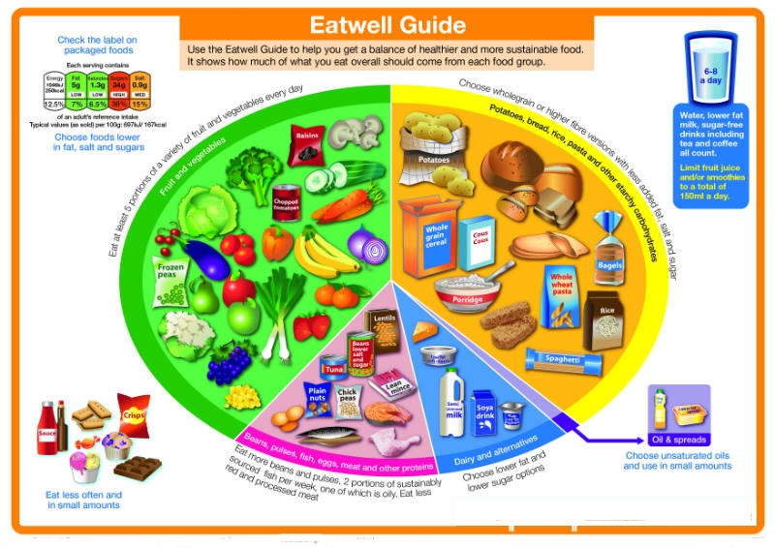

Slide 5
1. Potatoes, bread, rice,pasta & other starchy foods
Starchy foods will delay feelings of hunger, as well as
being a good source of energy and B vitamins

Slide 6
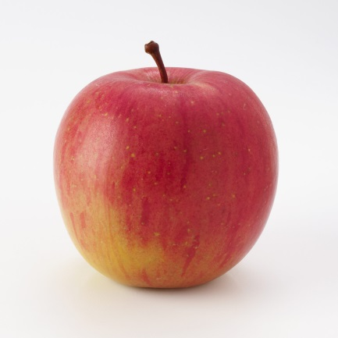
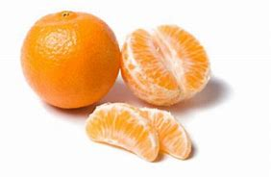
2. Fruit and vegetables
Provide vitamins & minerals and fibre for a healthy diet.
Provide antioxidants which can reduce the risk of cancer.
Encourage 5 portions of fruit and vegetables everyday.
1 medium apple
1 medium banana
1 handful of grapes
3 heaped tablespoons of peas
2 small satsumas

Slide 7
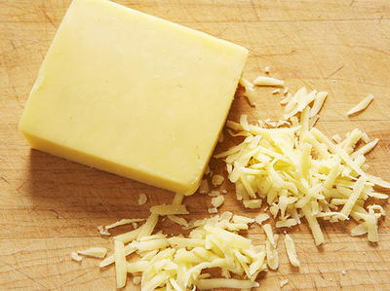
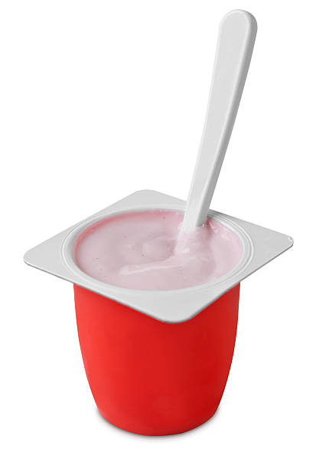
3. Dairy and other alternatives
Provides calcium, protein, vitamins B12, A and D
Helps strengthen bones and teeth

Slide 8
4. Beans, pulses, fish, eggs, meat and other proteins
Provides protein for growth & repair
Provides iron, B vitamins and minerals

Slide 9
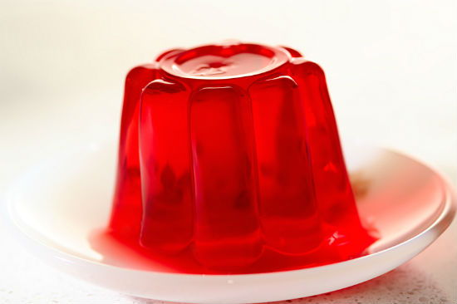
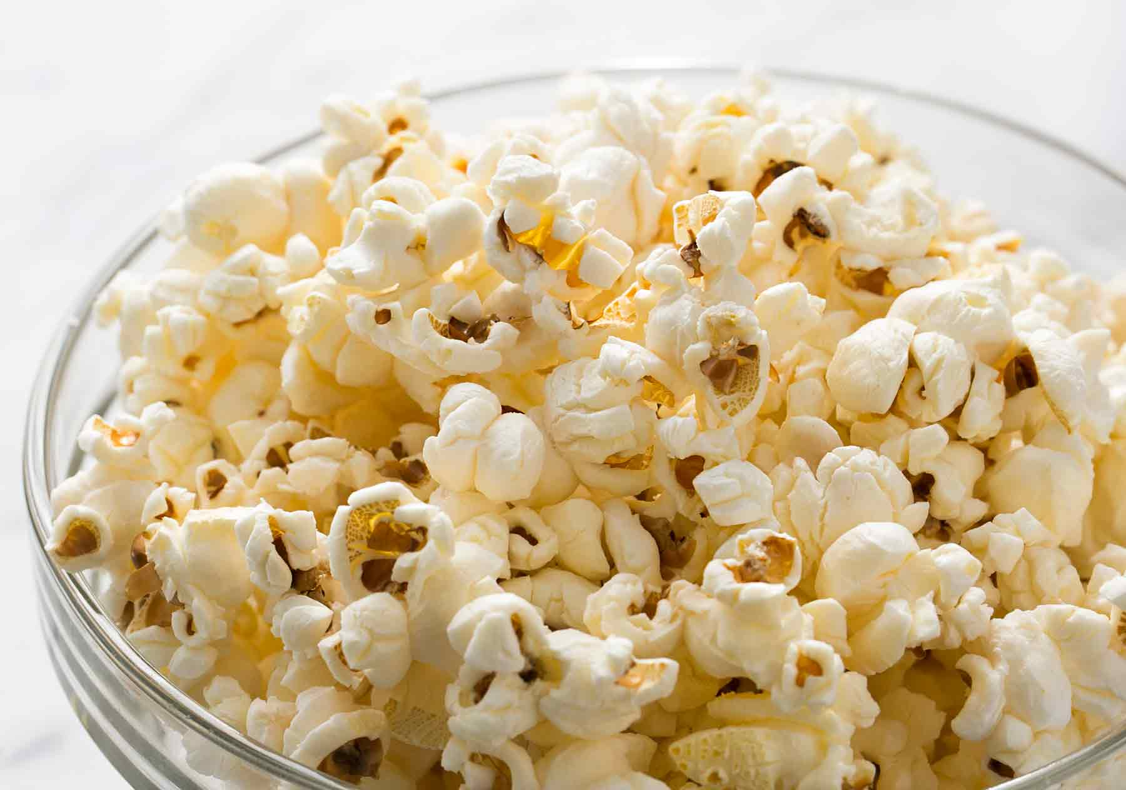
5. Healthier Treats
Encouraging your child not to bring sweets, chocolate, crisps
and fizzy drinks for break or lunch
Choose healthier options for your child’s lunchbox!

Slide 10
Thirst Quenchers
It is important that
your childdrink enough
during the day, so that
they don’t become
dehydrated and tired.
It is important that your child drinks enough during the day, so that they don’t become dehydrated and tired

Slide 11
Top Tips
Add variety to their lunchbox by using different types of bread
Use less spreads and avoid mayonnaise to cut down on fat
Let your your child get involved by helping to make their own lunch
Try out new ideas at teatime or at the weekend before including them in their lunchbox.

Slide 12
 | More helpful tips...
Freeze fruit for an alternative snack
Add lemon juice to cut up fruit to stop it going off!
Choose unsalted popcorn rather than crisps
Choose bright and colourful foods
Try and get your child excited about their lunchbox, let them pick a lunchbox or even decorate their own

Slide 13
Healthy Lunchbox Ideas

